Slide 1
MODULE 1
Introduction to Artificial Intelligence
www.headstart-ai.eu

Slide 2
Module overview
01
What is Artificial Intelligence?
This module introduces the basics of Artificial Intelligence (AI) and shows how it's already part of our daily lives. Learners will explore how AI mimics human thinking, understand the difference between traditional and generative AI, and reflect on how tools like ChatGPT and TikTok use AI. The session also highlights the gender gap in AI careers and encourages young women to see AI as a tool for creativity, opportunity, and positive change.
02
A closer look at Generative AI
03
Artificial Intelligence in everyday life
04
Current status of women in AI
05
Recap and key terms

Slide 3
By the end of this module, learners will be able to:
Understand what AI is and how it mimics human intelligence
Identify key technologies behind AI, like Machine Learning and Natural Language Processing
Explain the difference between traditional AI and Generative AI (GenAI)
Discover how GenAI creates new content like text, images, and music
Spot where AI is used in your everyday life – from TikTok to Duolingo
Reflect on the gender gap in AI and why more women are needed in the field
Recognise how AI skills can boost your career, creativity, and confidence
Learning Objectives Module 1

Slide 4
01
What is Artificial Intelligence

Slide 5
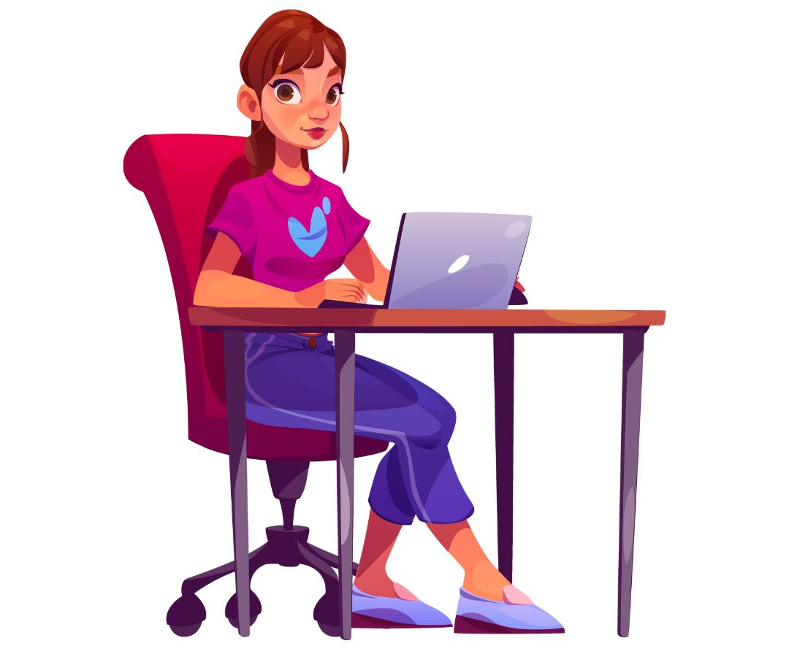
Have YOU heard of Artificial Intelligence?
Can you think of any examples of when YOU have used Artificial Intelligence

Slide 6
01
What is Artificial Intelligence?
**Even this video was generated using AI!?
Notes:
Artificial Intelligence, or AI, is a type of technology that enables machines to think and learn like humans. Imagine a robot that can recognise your voice, answer questions, or even play chess with you. That’s AI in action!
At its core, AI involves creating computer programs that can solve problems, make decisions, and improve over time. These smart programs can analyse data, recognise patterns, and adapt to new information. Whether it’s a self-driving car or a personalised recommendation on YouTube, AI is all about making our lives easier and more exciting by mimicking human intelligence.

Slide 7
Core technologies of Artificial Intelligence
AI relies on several key technologies that enable it to function and evolve. Let’s explore some of the core technologies behind AI:
Machine
Learning
Computer Vision
Deep Learning
Title
Title
Natural
Language Processing
Robotics

Slide 8
What is Machine Learning?
Machine learning is a subset of AI where computers learn from data. Imagine teaching a computer to recognise different types of animals. By feeding it thousands of images of cats, dogs, and birds, the computer learns to identify these animals on its own.
Machine learning is like teaching a computer to be smart by showing it lots of examples.
WATCH the 3-minute video ABOVE!

Slide 9
What is Deep Learning?
Deep learning is a specialised form of machine learning. It uses neural networks, which are designed to mimic the human brain. These networks have multiple layers that process information in stages. WATCH 4-minute video BELOW
Notes:
Deep learning is especially good at tasks like recognising speech and images. For instance, when you use voice commands on your phone, deep learning helps it understand what you’re saying.

Slide 10
What is Natural Language Processing (NLP)?
NLP allows computers to understand and respond to human language.
This technology is what makes chatbots and virtual assistants like Siri and Alexa possible.
NLP can analyse text, recognise speech, translate languages, and even generate human-like text. It’s what helps your phone understand and respond when you ask it for the weather forecast or to send a message.
WATCH the 2-minute explainer video on NLP ABOVE!

Slide 11
What is Robotics?
AI and robotics often go hand in hand. Robotics involves creating machines that can perform tasks in the physical world. When combined with AI, robots can navigate, make decisions, and interact with their environment intelligently.
Think of a robot vacuum that cleans your house; it uses AI to navigate around furniture and avoid obstacles.
WATCH the 4-minute explainer video on Robotics withing AI…

Slide 12
What is Computer vision?
Computer vision enables machines to interpret and understand visual information from the world. This technology is used in self-driving cars, which need to recognise and respond to road signs, pedestrians, and other vehicles.
It also powers facial recognition systems and helps diagnose medical images in healthcare.
WATCH the 2-minute explainer video on Computer Vision…

Slide 13
02
A specific look at Generative AI

Slide 14
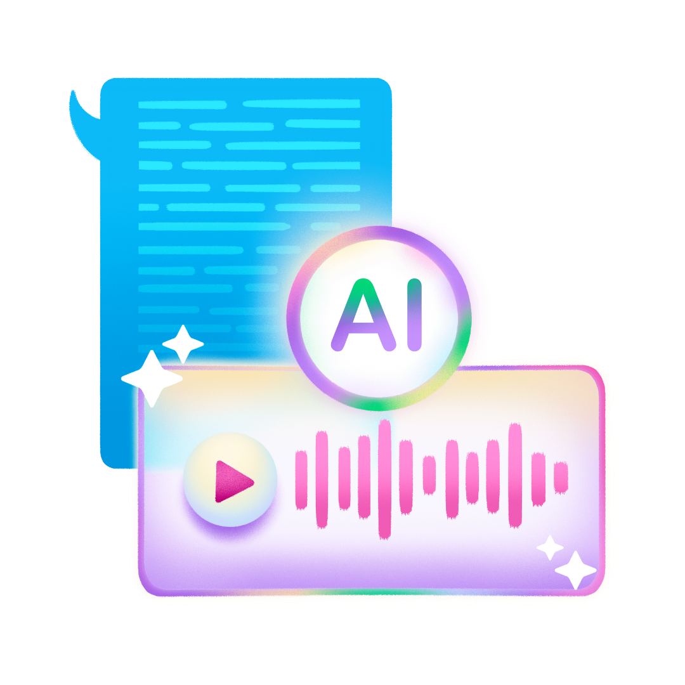
What is Generative AI?
Now you have an understanding of Artificial Intelligence, understanding Generative AI (GenAI) is easy!
Regular AI vs. Generative AI – What’s the Difference?
Traditional AI 🤓 | Generative AI 🎨
Analyses data and makes decisions | Creates new content from scratch
Used for tasks like fraud detection or predicting trends | Can generate text, images, music, and more
Think of AI as a really smart assistant | Think of GenAI as a creative artist
Notes:
References
https://medium.com/@randyip9/generative-ai-for-dummies-5-min-read-282819bce61c
https://workativ.com/ai-agent/blog/generative-ai-dummies
https://binmile.com/blog/generative-artificial-intelligence/
https://bernardmarr.com/the-difference-between-generative-ai-and-traditional-ai-an-easy-explanation-for-anyone/

Slide 15
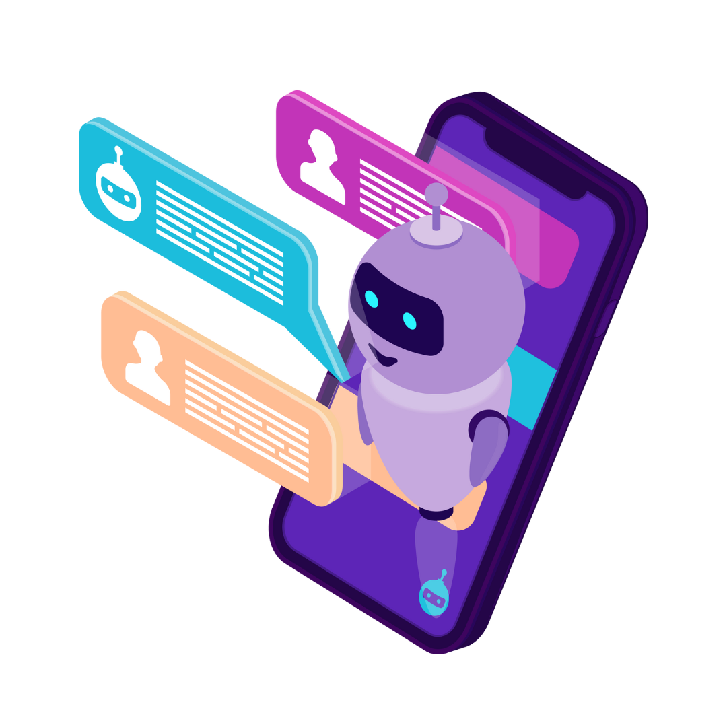
So, what makes Generative AI so popular?
While traditional AI focuses on making predictions, GenAI goes a step further—it creates or GENERATES things like! Imagine asking AI to write a poem, generate a digital painting, or even compose a song—that’s GenAI in action!
For example, if you ask: “What’s the difference between a cow and a bull?”
A GenAI model searches huge amounts of text data from books, websites, and articles, and generates a clear, human-like response. And it doesn’t stop at text—GenAI can create images, writes code, makes music, videos and even designs clothes!
Notes:
References
https://medium.com/@randyip9/generative-ai-for-dummies-5-min-read-282819bce61c
https://workativ.com/ai-agent/blog/generative-ai-dummies
https://binmile.com/blog/generative-artificial-intelligence/
https://bernardmarr.com/the-difference-between-generative-ai-and-traditional-ai-an-easy-explanation-for-anyone/

Slide 16
How Does Generative AI Work?
GenAI learns patterns from huge datasets and uses special AI models to create new content. There are two big types of models behind GenAI:
1. Generative Adversarial Networks (GANs)
GANs work like a creative competition between two AIs:
The Generator – Creates fake content (like a new face or painting).
The Discriminator – Tries to spot whether the content is real or fake.
Notes:
References
https://medium.com/@randyip9/generative-ai-for-dummies-5-min-read-282819bce61c
https://workativ.com/ai-agent/blog/generative-ai-dummies
https://binmile.com/blog/generative-artificial-intelligence/
https://bernardmarr.com/the-difference-between-generative-ai-and-traditional-ai-an-easy-explanation-for-anyone/

Slide 17
How Does Generative AI Work?
For example…Imagine a GAN trying to create realistic pictures of cats.
At first, the AI’s drawings might look like blurry blobs, but over time, as the Discriminator keeps rejecting bad images, the Generator gets better—until it produces a perfectly realistic cat that never existed before!
Generative Adversarial Networks (GANs)s are used for….
✅ Creating deepfake videos (like AI-generated celebrity voices!)
✅ Removing noise from images (sharpening blurry photos)
✅ Generating realistic game characters & avatars
Notes:
References
https://medium.com/@randyip9/generative-ai-for-dummies-5-min-read-282819bce61c
https://workativ.com/ai-agent/blog/generative-ai-dummies
https://binmile.com/blog/generative-artificial-intelligence/
https://bernardmarr.com/the-difference-between-generative-ai-and-traditional-ai-an-easy-explanation-for-anyone/

Slide 18
ACTIVITY
EXPLAIN GANs IN AS IF YOU WERE EXPLAINING TO A CHILD

Slide 19
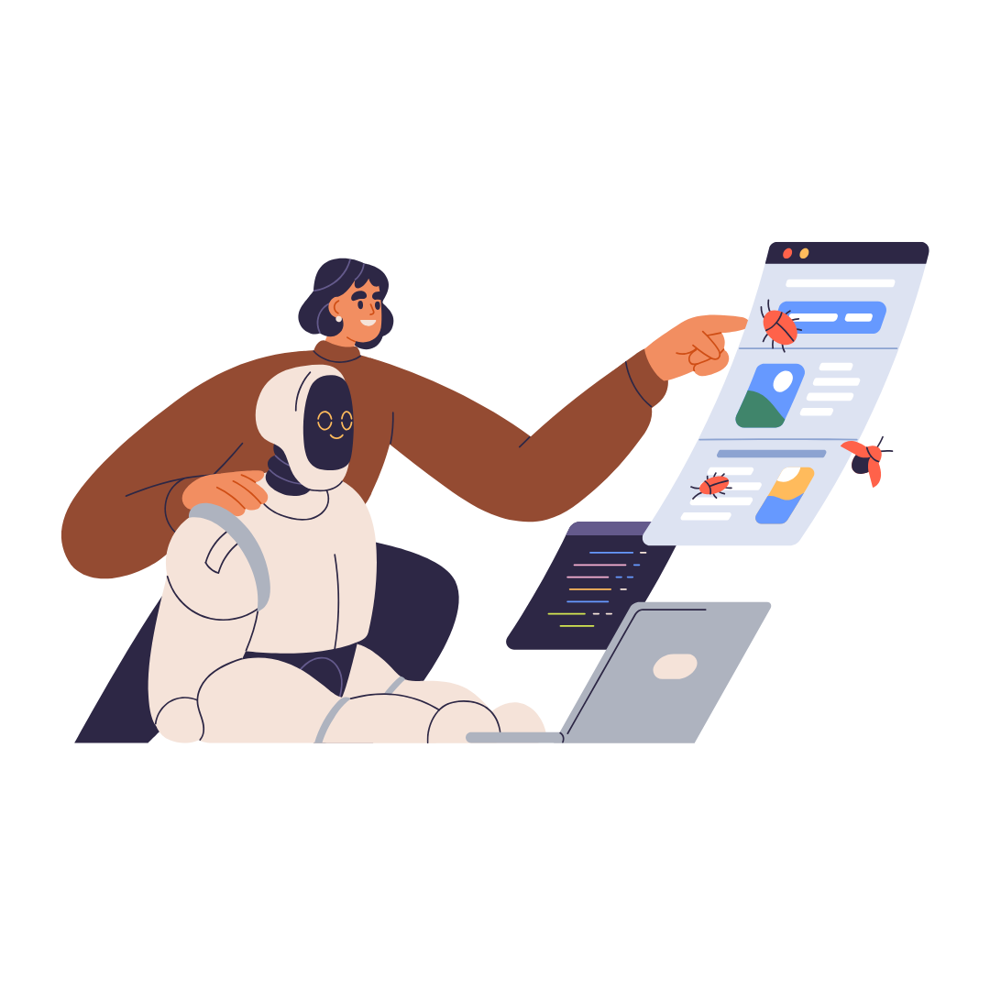
2. Transformer Models (The Brain of AI Chatbots)
If GANs generate images, then Transformers are the brains behind chatbots and writing AI. Transformers understand text by reading large amounts of data and predicting the next word in a sentence. That’s how tools like ChatGPT can write essays, summarise articles, and even crack jokes!
For example, If you type "Once upon a time, there was a...", a Transformer AI predicts what words should come next—like "brave princess who discovered a hidden kingdom!"
Notes:
References
https://medium.com/@randyip9/generative-ai-for-dummies-5-min-read-282819bce61c
https://workativ.com/ai-agent/blog/generative-ai-dummies
https://binmile.com/blog/generative-artificial-intelligence/
https://bernardmarr.com/the-difference-between-generative-ai-and-traditional-ai-an-easy-explanation-for-anyone/

Slide 20
2. Transformer Models (The Brain of AI Chatbots)
Popular Transformer Models
GPT (Generative Pre-trained Transformer) used in ChatGPT for writing and coding.
BERT (Bidirectional Encoder Representations from Transformers) used by Google to understand search queries.
RoBERTa (Robustly Optimised BERT) an advanced version of BERT used in AI research.
Transformers are used for….
✅ AI chatbots (like Snapchat’s My AI & ChatGPT)
✅ Translating languages (like Google Translate)
✅ Generating scripts, captions, and social media posts
Notes:
References
https://medium.com/@randyip9/generative-ai-for-dummies-5-min-read-282819bce61c
https://workativ.com/ai-agent/blog/generative-ai-dummies
https://binmile.com/blog/generative-artificial-intelligence/
https://bernardmarr.com/the-difference-between-generative-ai-and-traditional-ai-an-easy-explanation-for-anyone/

Slide 21
3. What Can Generative AI Do?
🎨 Creating Art & Designs
Artists and designers are using AI to generate unique paintings, graphics, and animations. Some AI-generated artwork has even been sold for millions of dollars!
For example, AI apps like DALL·E can turn text prompts into stunning digital art.
Video link

Slide 22
3. What Can Generative AI Do?
🎭 Making Deepfake Videos
AI can create realistic videos of people saying things they never actually said! This can be fun for entertainment, but also dangerous if misused (which is why digital literacy is important!).
For example, have you ever seen a video of an AI-generated celebrity voice? That’s deepfake tech at work!
Video link

Slide 23
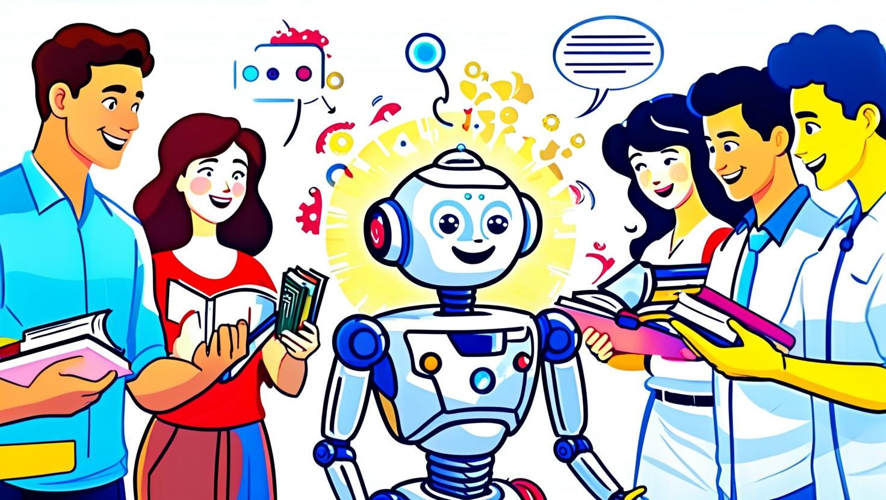
Activity
HOW IS GENERATIVE AI TRAINED?
Look at this image above, it was created with generative AI, and it's meant to show how AI learns.
What do you notice?
How does the picture show AI learning?

Slide 24
Activity
HOW IS GENERATIVE AI TRAINED?
The robot in the middle represents artificial intelligence.
It's surrounded by people who are talking to it and showing it books. These people are the human "trainers."

Slide 25
Activity
HOW IS GENERATIVE AI TRAINED?
The "trainers" are sharing data with the AI to help it learn.
The data is represented by the books and the speech bubbles.

Slide 26
03
AI in your daily life

Slide 27
AI plays a bigger role in your life than you might realise. It’s like having a silent assistant, always working in the background to personalise your experiences, save you time, and even improve your well-being.
In the next few slides we will look at how you use AI everyday, and you might not even realise it
AI in everyday life

Slide 28
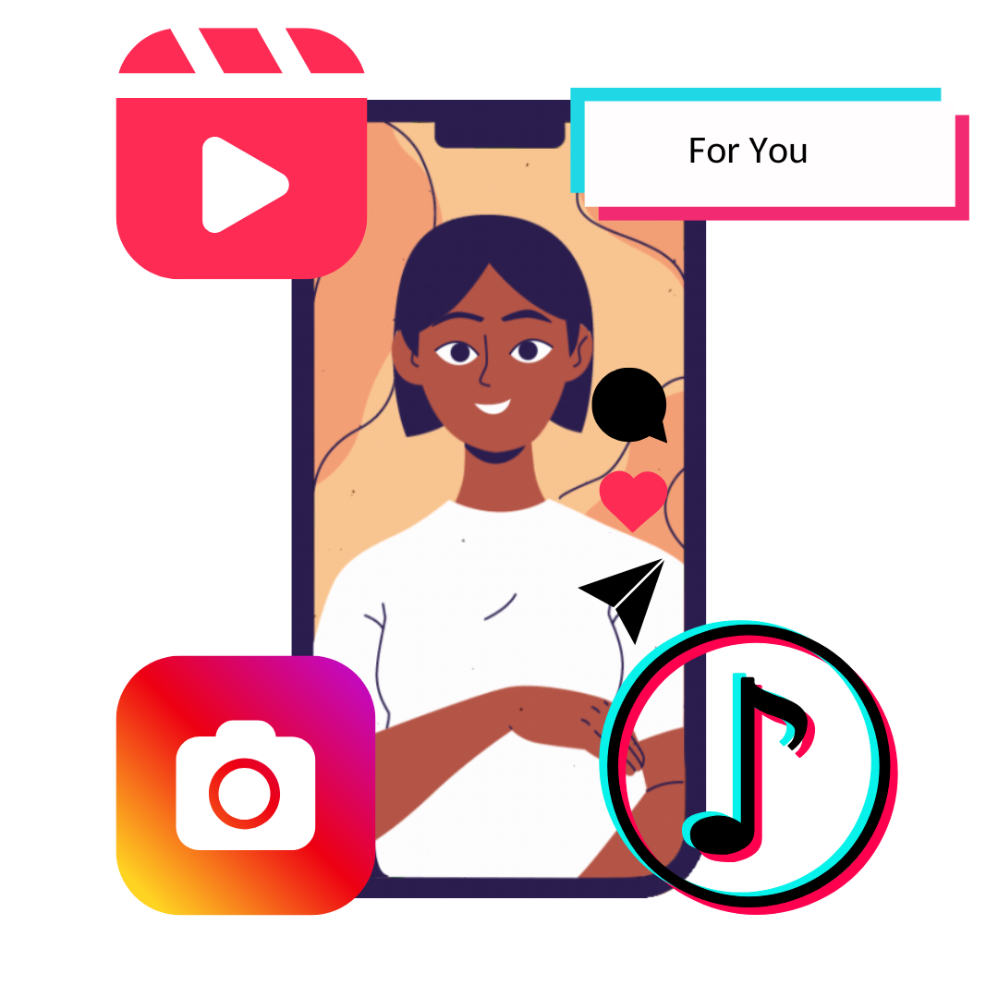
AI in Social media
What it does
Analyses your behaviour (likes, comments, time spent watching) to recommend content you’ll love.
Customises your feed to reflect your interests, from trending videos to influencer posts.
Helps platforms predict what’s most relevant to you.
Example
TikTok’s "For You" page uses AI to learn your preferences with incredible accuracy.
Instagram suggests reels, ads, hashtags or accounts you might find inspiring or fun to follow.

Slide 29
AI in Online Shopping
Example 1 Clothing apps like ASOS recommend styles based on your size, previous buys, and seasonal trends.
What it does
Tracks your browsing habits and purchase history to recommend products you might want.
Offers personalised deals or reminders for items left in your cart..
Example 2 Amazon suggests "frequently bought together" items, saving time when shopping for gifts or essentials.

Slide 30
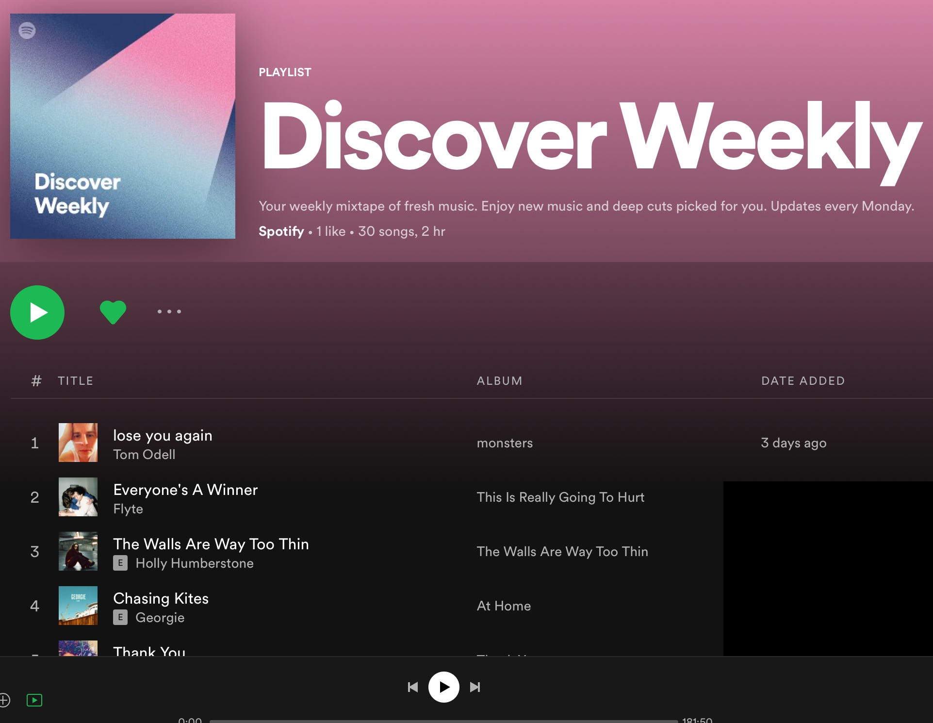
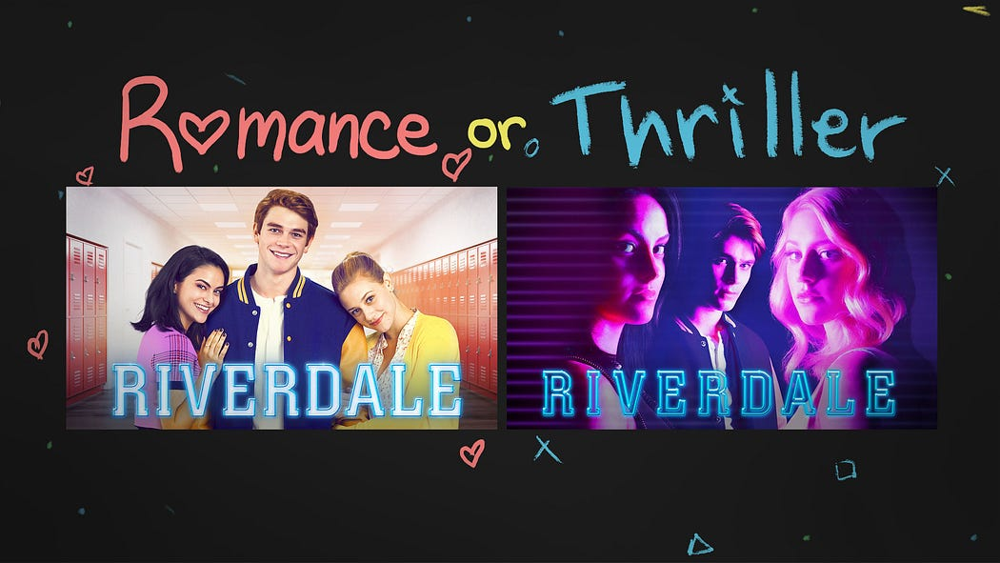
AI in Entertainment Apps
Example 1 Spotify’s "Discover Weekly" playlist is powered by AI, combining what you like with trends among listeners with similar tastes.
What it does
Curates playlists, recommends shows, and suggests content based on data of past behaviour.
Learns your preferences to create unique experiences every time you log in.
Example 2 Netflix uses AI to design thumbnails that appeal specifically to you, making shows more enticing. E.g. Same Riverdale Series, but two different artistic image thumbnails, based on user’s past preference for romance (sweet smiles) or thriller (serious, dramatic looks) genres.
Notes:
https://becominghuman.ai/how-netflix-uses-ai-and-machine-learning-a087614630fe

Slide 31
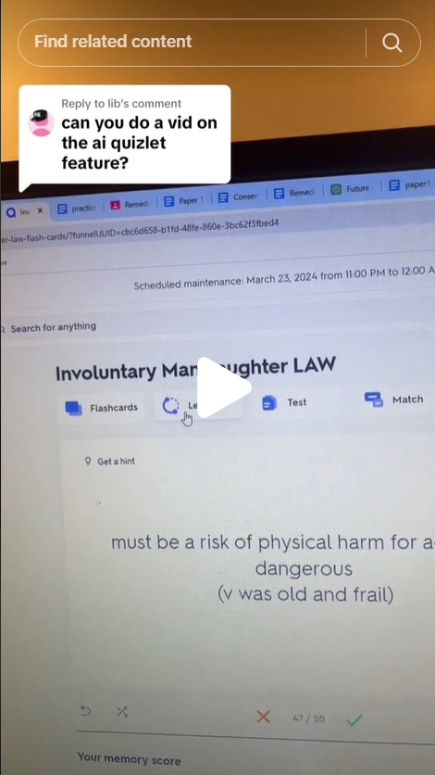
AI in Learning Apps
Example 1 Duolingo Max has new AI features e.g. Explain My Answer (An AI-powered tool that helps learners),Roleplay (An AI-powered tool that helps learners practice real-world conversations by writing instead of talking)
Video Call (A feature that lets learners have real-life conversations with Lily.) Watch this explainer video
What it does
Simplifies complex topics, offers personalised practice exercises, and tracks your progress.
Uses adaptive learning algorithms to tailor content to your pace and level.
Example 2 Quizlet’s AI-powered flashcards predict what you need to study more based on your past mistakes. Watch this TikTok explainer video.
Notes:
https://becominghuman.ai/how-netflix-uses-ai-and-machine-learning-a087614630fe

Slide 32
Objective of the activity is;
Participants explore their own lives to uncover where AI is at work and reflect on its impact.
Activity
Open an app or tool you use daily (e.g., Spotify, Snapchat, TikTok).
Answer these questions…
Can you find one feature that uses AI?
How does it make your experience better?
AI Hunt Challenge

Slide 33
Objective of the activity is;
Participants explore their own lives to uncover where AI is at work and reflect on its impact.
Activity
On your own or form small teams (2-3 participants).
Pick one app or activity and answer…
What does AI do in this app?
Why is it useful or fun?
How could you improve it if you were designing it?
AI Hunt Challenge

Slide 34
04
The current status of women in AI

Slide 35
Women working in AI
A study by company “Interface” conducted an analysis of data on nearly 1.6 million AI professionals worldwide reveals stark gender imbalances. Women comprise only 22% of AI talent globally, with even lower representation at senior levels – occupying less than 14% of senior executive roles in AI.
Notes:
https://www.interface-eu.org/publications/ai-gender-gap#:~:text=Our%20analysis%20of%20data%20on,senior%20executive%20roles%20in%20AI.

Slide 36
Women using AI for work
Harvard Rembrand Professor wrote a paper; “Global Evidence on Gender Gaps and Generative AI.” Koning’s research shows women are adopting AI tools at a 25 percent lower rate than men on average, despite the fact the benefits of AI would apply equally to men and women.
If women continue in avoid using generative AI, not only will businesses miss out on major productivity gains, but women will fall behind in building valuable skills they need to succeed. That could widen the persistent gender gap in wages and career opportunities.
Notes:
https://www.library.hbs.edu/working-knowledge/women-are-avoiding-using-artificial-intelligence-can-that-hurt-their-careers
Women consistently show lower adoption rates
To compare how women and men use generative AI tools like ChatGPT and Claude, the researchers examined 18 studies involving more than 140,000 college students and workers, including business owners, data analysts, software developers, and executives from countries including the United States, Sweden, Mexico, China, and Morocco. A 2024 survey by the Federal Reserve Bank of New York, for example, found that half of men used generative AI in the previous 12 months, compared with about a third of women. Across most of the studies, the share of women adopting AI tools was 10 to 40 percent smaller than the share of men. “When we aggregate them, our best estimate is that there is a 25 percent gap,” says Koning, the Mary V. and Mark A. Stevens Associate Professor of Business Administration.

Slide 37
Benefits of pursuing AI?
AI Jobs Are Well-Paid 💰
Careers in AI and tech pay significantly higher salaries compared to many other industries. For example, AI Engineers, Data Scientists, and UX Designers in AI can earn €60,000–€100,000+ per year!
Even entry-level roles offer competitive salaries.
AI is the Future – Be a Part of It! 🌍
AI is revolutionising every industry—from healthcare to fashion, music, gaming, and sustainability. The world needs more women shaping this future! Imagine creating AI that fights climate change, improves mental health apps, or designs fashion trends using AI-generated art. If YOU want to make a difference, AI is a tool that can help them solve real-world problems.

Slide 38
Benefits of pursuing AI?
AI Careers Are Flexible – Work from Anywhere! 🌎🏠
Tech & AI jobs often offer:
Remote work options (work from anywhere!)
Flexible hours (work when you're most productive)
Freelance & entrepreneurship opportunities (start your own AI-based business!)
If you value work-life balance and independence, and AI careers provide that freedom.
AI Skills Will Make You Stand Out in ANY Career 💼✨
Even if you don’t want to be an AI engineer, knowing AI basics will give you a huge career advantage.
Marketing & Social Media – AI helps create viral campaigns & personalised ads.
Education – AI creates interactive learning tools for students.
Journalism & Writing – AI helps generate engaging stories & summaries.
Healthcare – AI assists doctors in diagnosing diseases faster.

Slide 39
Time for change? It ends with you…
You can start on your AI journey now, and look you’ve already started by taking this module and you’ve gained some great knowledge of what Artificial intelligence is! Keep going, the next few modules will build your skills and knowledge even more.
https://headstart-ai.eu/visual-resource-hub/

Slide 40
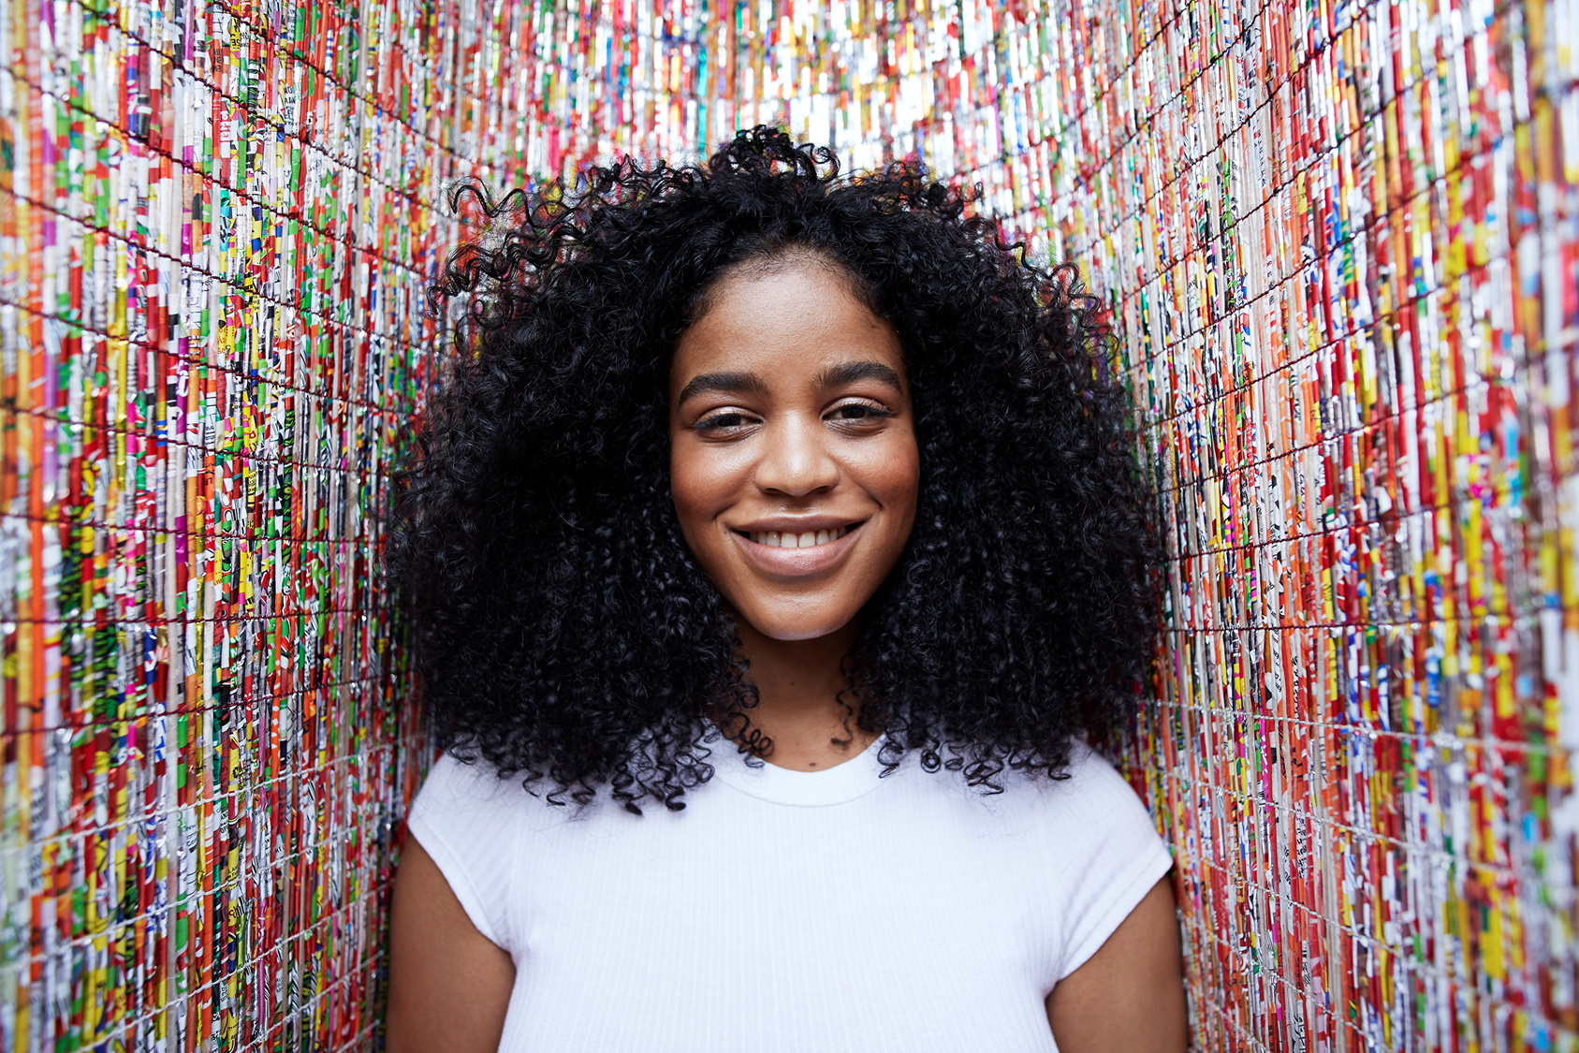
05
Recap and key terms

Slide 41
Key terms to remember!!
AI Tool – A digital application that uses artificial intelligence to help you do tasks like writing, designing, or generating ideas.
ChatGPT – A text-based AI that responds to prompts with answers, ideas, summaries, stories, and more.
Canva AI – A design tool that uses AI to help create images, text, and layouts easily.
Prompt – The question or instruction you give to an AI tool to get a response.
Magic Write – A Canva AI feature that generates written content like headlines, social media text, or event taglines.
Text-to-Image – AI that turns a written description into a visual image.
Bias – When AI reflects unfair assumptions or stereotypes from the data it was trained on.
Misinformation – Incorrect or misleading information created or shared by AI.
Fact-checking – Verifying if the information from AI is true using reliable sources.
Confidence – Believing in your ability to try, test, and use AI tools creatively and responsibly.

Slide 42
Well Done!!!
www.headstart.eu

