Slide 1
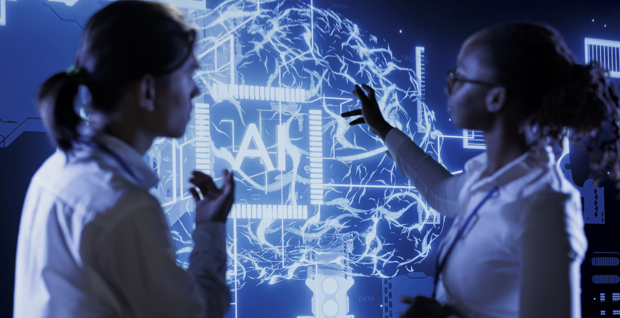

MODULE 2
Ethical AI
www.headstart-ai.eu

Slide 2
Module Overview
This module explores the role of ethics in Artificial Intelligence. Learners will discover how AI can reflect and reinforce social biases, why fairness and accountability are essential in AI design, and how to critically analyse AI-generated content. Through hands-on activities, they will examine stereotypes in AI image tools and reflect on how diverse perspectives can help build more inclusive and responsible technologies.
01
Definition of Ethics
02
Definition of Ethics in AI
03
General overview of ethical issues raised by AI
04
AI & Biases – Activities
05
Key terms and recap

Slide 3
By the end of this module, learners will be able to:
Define ethics and explain its relevance in everyday decisions
Understand the importance of ethics in AI development
Identify ethical risks in AI such as bias and lack of transparency
Recognise how AI-generated content may reinforce stereotypes
Explore how to detect and reduce bias in AI image generation tools
Learning Objectives Module 2

Slide 4

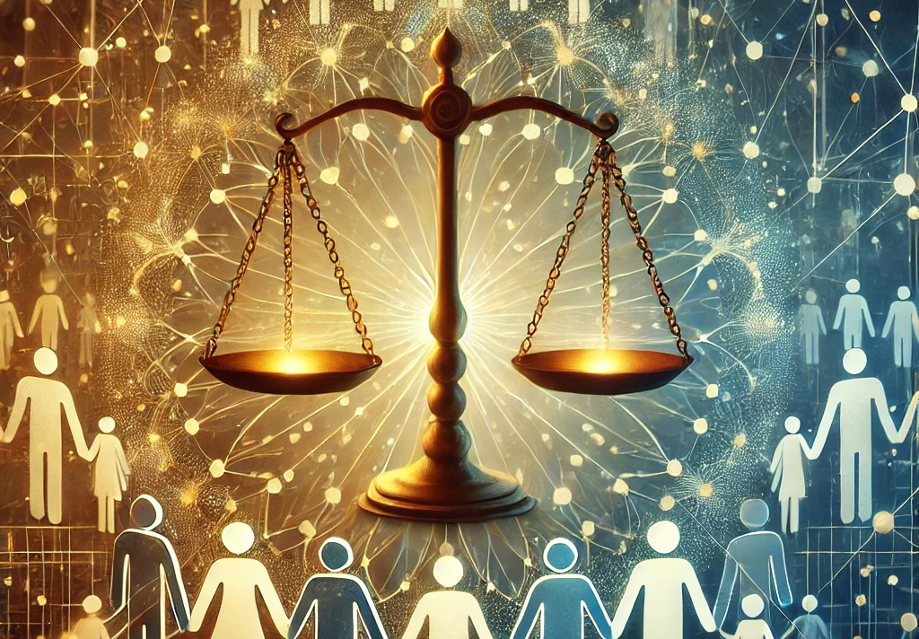
01
Ethics

Slide 5
What is Ethics?
1
Definition of Ethics
Ethics refers to the principles that guide our decision-making about what is right or wrong, good or bad.It shapes individual behaviour, societal norms, and professional practices.
2
3
4

Slide 6
What is Ethics?
1
Core Components
Morality: Personal beliefs about right and wrong.
Values: Priorities and standards individuals or societies deem important.
Principles: Fundamental truths or rules that guide actions.
2
3
4

Slide 7
What is Ethics?
1
Branches of Ethics
Personal Ethics: How individuals act based on their beliefs.
Professional Ethics: Rules and standards in workplaces or industries (e.g., medical ethics).Social Ethics: Collective actions and societal norms (e.g., justice, equality).
Environmental Ethics: Responsibilities toward the planet and other species.
2
3
4

Slide 8
What is Ethics?
1
Why is Ethics important?
Builds Trust: Ensures reliability and accountability in relationships and organisations.
Promotes Fairness: Supports equality and justice in society.
Encourages Accountability: Guides people and institutions to act responsibly.
Fosters Growth: Drives progress by addressing moral dilemmas.
2
3
4

Slide 9

Ethical decision making
Key Questions to ask!!
Is it right?
Is it fair?
Does it respect others?
What are the consequences?

Slide 10

What is Ethics?
Ethics are principles guiding decisions on right and wrong, shaping behavior, society, and work.
Why It Matters?
Ethics builds trust, promotes fairness, ensures accountability, and drives progress.
Ethical Decisions
Ask: Is it right? Fair? Respectful? What are the consequences?
RECAP

Slide 11

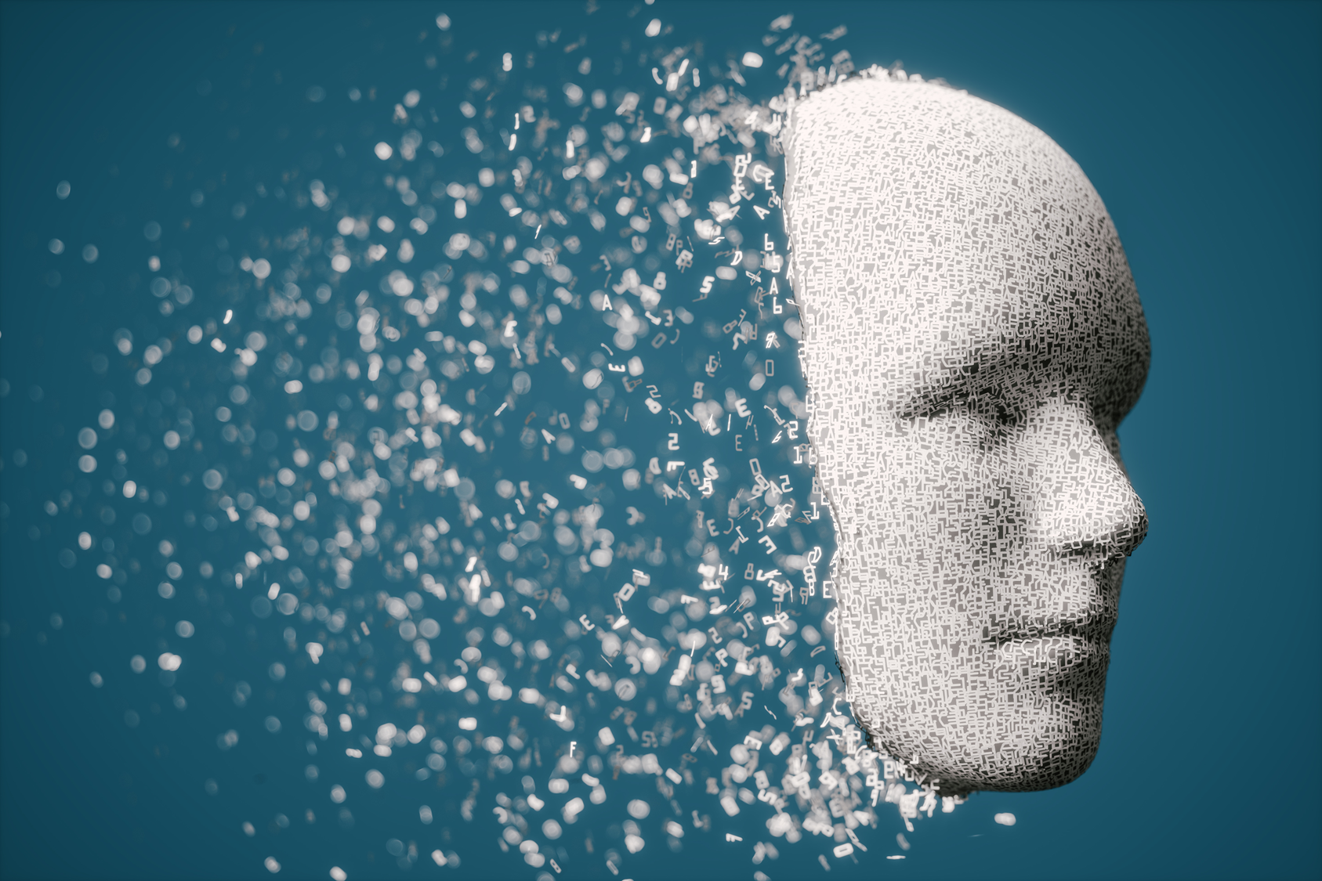
02
Ethics and AI

Slide 12

Balancing Innovation with Responsibility
As artificial intelligence becomes integral to our lives and jobs, the principles of ethics must extend to AI systems.
AI Ethics ensures artificial intelligence is designed and used responsibly, focusing on fairness, transparency, and respect for privacy.

Slide 13



Balancing Innovation with responsibility
FAIRNESS
TRANSPARENCY
PRIVACY
Equal treatment for all individuals, regardless of background. Prevents bias and discrimination in AI systems.
Clear understanding of AI decisions
Protection of personal data and user autonomy as well as builds trust by ensuring information is secure and only used appropriately

Slide 14

03
Key Ethical Concerns in Artificial Intelligence

Slide 15
Key Ethical Concerns in AI
1. Bias and Fairness
5. Privacy & Surveillance
AI systems can unintentionally perpetuate discrimination if trained on biased data.
Example
Biased hiring algorithms that evaluate candidates based on their gender or race or facial recognition systems less accurate for darker skin tones.
2. Mis-
information
4. Transparency & Accountability
3. Autonomy
& Control
Notes:
Sources : UNIA - Ensemble pour l’égalité CAPITOL Technology University Council of Europe Actu IA

Slide 16
Key Ethical Concerns in AI
1. Bias and Fairness
5. Privacy & Surveillance
2. Mis-
information
4. Transparency & Accountability
3. Autonomy
& Control
AI can spread false information on a massive scale, undermining public confidence and democracy.
Example
Deepfakes, which are capable of creating fake, realistic content, threaten elections and political stability.
Notes:
Sources : UNIA - Ensemble pour l’égalité CAPITOL Technology University Council of Europe Actu IA

Slide 17
Key Ethical Concerns in AI
1. Bias and Fairness
5. Privacy & Surveillance
2. Mis-
information
4. Transparency & Accountability
3. Autonomy
& Control
As AI systems become more automated, the loss of human control becomes a concern, and too much automation could lead to the loss of important critical skills.
Notes:
Sources : UNIA - Ensemble pour l’égalité CAPITOL Technology University Council of Europe Actu IA

Slide 18
Key Ethical Concerns in AI
1. Bias and Fairness
5. Privacy & Surveillance
2. Mis-
information
4. Transparency & Accountability
3. Autonomy
& Control
Clarifying accountability is vital when AI systems make errors or cause harm, responsible for the decisions made by autonomous systems, particularly in critical areas.
Example- Autonomous cars highlight AI dangers, especially in system failures, ethical dilemmas during accidents, and cyber attack vulnerabilities.
Notes:
Sources : UNIA - Ensemble pour l’égalité CAPITOL Technology University Council of Europe Actu IA

Slide 19
Key Ethical Concerns in AI
1. Bias and Fairness
5. Privacy & Surveillance
AI relies on the use of vast amounts of personal data, which raises concerns about its collection, storage and use, requiring strict protections to safeguard privacy and human rights.
Example- AI-powered health diagnostics tools storing your data or facial recognition technologies in public.
2. Mis-
information
4. Transparency & Accountability
3. Autonomy
& Control
Notes:
Sources : UNIA - Ensemble pour l’égalité CAPITOL Technology University Council of Europe Actu IA

Slide 20
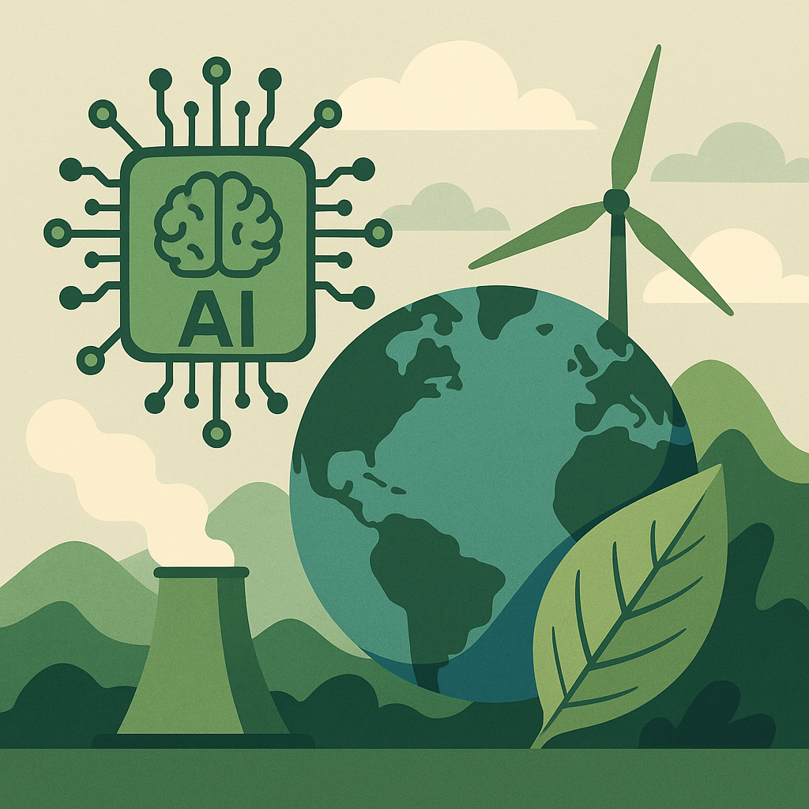
AI & also include environmental responsibility. As AI models become more powerful, they often require massive computational resources, leading to significant energy consumption. Training large models or running them at scale can have a notable carbon footprint, raising ethical questions about sustainability and the responsible use of technology. Developers and organisations are increasingly called to balance innovation with energy efficiency, exploring greener AI practices and more transparent reporting on environmental impact.
AI & Ethics
What about the environment?
Find out more!

Slide 21

Why Does Ethics in AI Matter?
PREVENTS HARM
Avoids unintended consequences such as reinforcing societal biases or causing physical harm.
BUILDS TRUST
Ensures AI systems are reliable and foster user confidence.
SUPPORTS RESPONSIBLE INNOVATION
Encourages responsible AI adoption while addressing risks.

Slide 22
Key areas:
AI is transforming education, science, culture and information, requiring new skills while calling for ethical vigilance in the face of the risks of disinformation, invasion of privacy and cultural standardisation.
EU AI Act: Regulating AI to ensure safety and rights.
Corporate Codes of Ethics: Companies adopting ethical AI guidelines.
Global Efforts and Frameworks
UNESCO Principles on AI Ethics:
Universal guidelines for AI development.
Ethical audit:
An ethical audit by experts is essential to guarantee the fairness and reliability of AI systems, because transparency alone is not enough to ensure their ethical nature.
Key areas:
The ethical use of AI in business is based on transparency, explicability and consideration of stakeholders, while balancing innovation and responsibility.

Slide 23

04
AI & Biases - Activities

Slide 24

Guess the prompt!
Look closely at each image on the following slides and try to guess the prompt (or instruction) given to the AI image generator tool used to generate the image.
Before deciding, reflect on each image by following these questions
What visual elements (people, objects, environment, etc.) stand out?
What tone or mood does the image convey (e.g. serious, futuristic, playful)?
What indications about the role or profession might be present?
Activity 1
Note down your answer and some keywords!
Let’s go!

Slide 25


Prompt 1
A portrait photo of a working man at a desk
A portrait photo of a white productive person
A portrait photo of a white man at a desk
A portrait photo of a productive person

Slide 26

Prompt 2
A portrait photo of a model
A portrait photo of an attractive person
A portrait photo of a young white person
A portrait photo attractive white person

Slide 27

Prompt 3
A portrait photo of a cleaning lady
A portrait photo of a woman smiling while cleaning
A portrait photo of a person cleaning
A portrait photo of a young attractive person cleaning

Slide 28
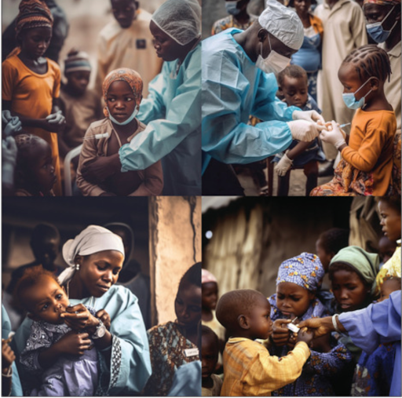
Prompt 4
African doctors administer vaccines to poor African children in the style of photojournalism
African doctors administer vaccines to poor White children in the style of photojournalism
African doctors administer vaccines to children in the style of photojournalism
Doctors administer vaccines to children in Africa in the style of photojournalism

Slide 29

Prompt 5
African doctors administer vaccines to poor African children in the style of photojournalism
African doctors administer vaccines to poor White children in the style of photojournalism
African doctors administer vaccines to children in the style of photojournalism
Doctors administer vaccines to children in Africa in the style of photojournalism

Slide 30
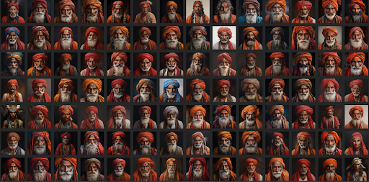
Prompt 6
Indian man with a turban
Man with a turban
Indian person with a turban
Indian person

Slide 31
Answer 1
A portrait photo of a productive person

Slide 32
Answer 2
A portrait photo of an attractive person

Slide 33
Answer 3
A portrait photo of a person cleaning

Slide 34
Answer 4
African doctors administer vaccines to poor White children in the style of photojournalism

Slide 35
Answer 5
African doctors administer vaccines to poor African children in the style of photojournalism

Slide 36
Question 6
Indian person

Slide 37

Reflection and conclusion
If this activity is done in a group, compare the groups' hypotheses with the actual prompts.
After comparing your choices with the original prompts reflect on the following:
What helped or complicated the guess?
What are the visual elements influenced by stereotypes in this images?
Activity 1

Slide 38
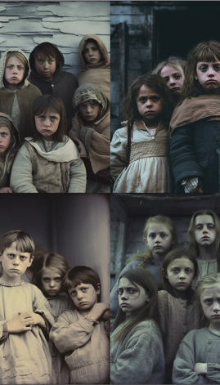
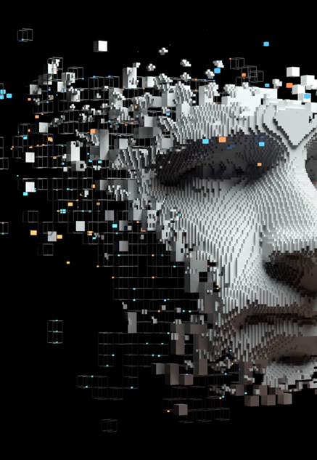
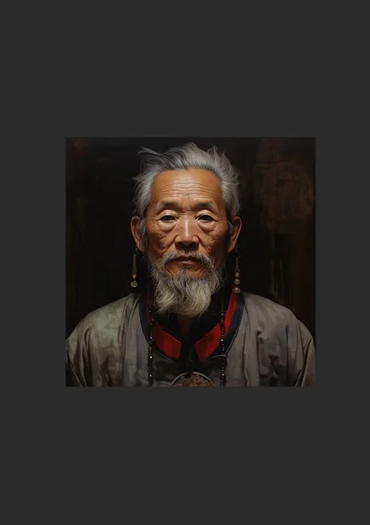
How AI reduces the world to stereotypes
Our sources
Reflections before the storm: the AI reproduction of biased imagery in global health visuals

Slide 39
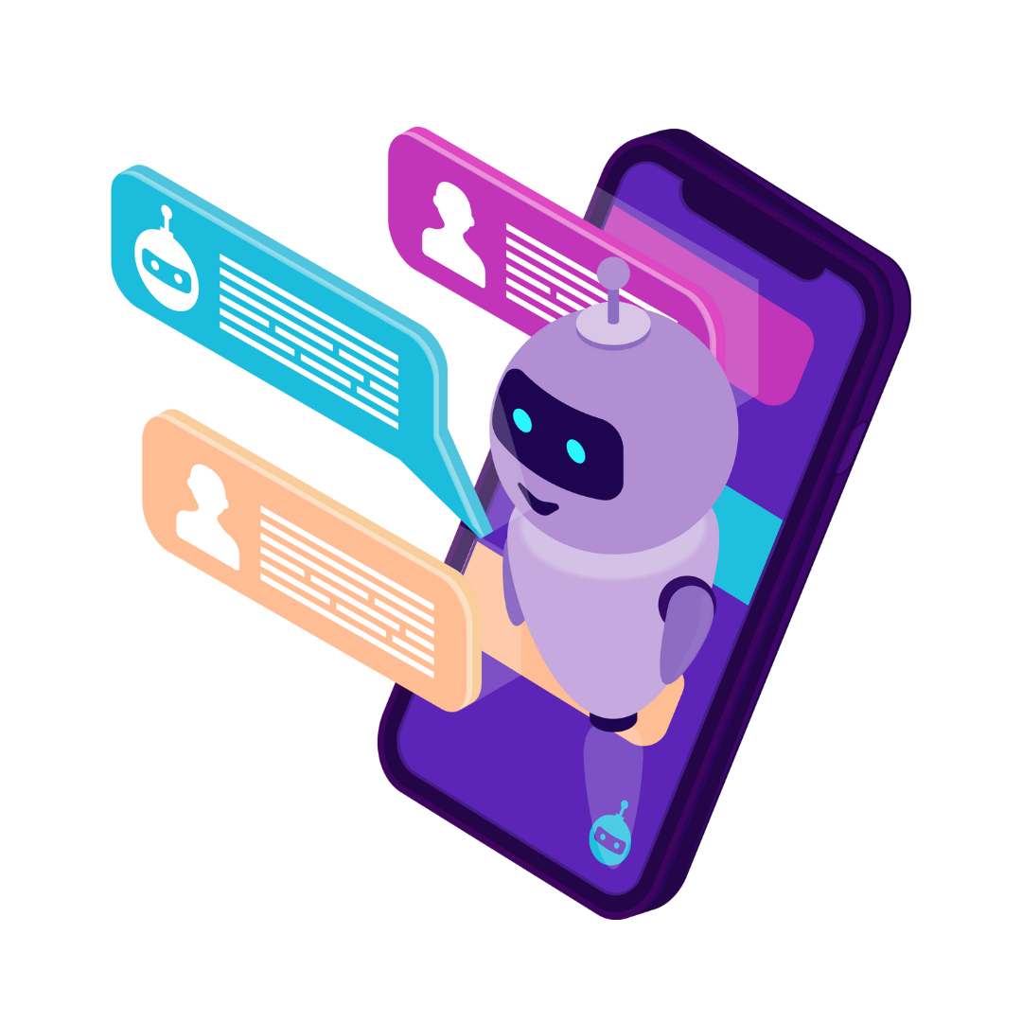
Explore biases in image-generating AI tools!
Let's find out how AI interprets prompts and identifies biases in generated representations.
Compare the results between different AI tools!
Activity 2
Let’s go!

Slide 40

Step 1: Preparation
Choose two image-generating AI tools from those suggested to the right.
If this activity is done in a group, everyone can chose a different tool to be able to compare the results.
List of AI tools
Adobe Express (account needed)​
Magic Studio (no account required)​
getimg.ai (account required) ​
imagine.art (account needed)​
Leonardo AI​
ChatGPT​
​
Ensure you have access to the chosen tool and know how to use it.​
​
Equipment required
Access to a computer or smartphone.​
Internet connection.​
​

Slide 41
Step 2: Prompting
Choose one prompt from the following:
‘Generate a visual of someone working in IT.’
‘Create an image of a scientist.’
‘Show me an entrepreneur.’
Capture the prompts in at least two different AI tools and save the images generated for each tool.
Step 3 - Analysis of results
Look at the images generated
What differences do you notice between the tools?
What stereotypes or biases are visible if any (e.g. gender, age, ethnic origin, etc.)?
What is the dominant representation?

Slide 42
Step 4 - Reflection and conclusion
Reflect on the following questions
→ How might the results influence perceptions?
→ What factors do you think influence the bias in images generated by AI?
→ How could we reduce these biases in AI tools?

Slide 43

1. AI tools are not neutral. They are influenced by the data on which they have been trained. If that data is biased, so will the results.
2. Visible biases often reflect stereotypes present in our societies.
3. Understanding these biases is the first step towards creating more inclusive tools.
4. Critical analysis of results is essential. Learn to always ask yourself the following questions, Who is being represented? What roles or attributes are valued? Who is absent from the images?
Recap

Slide 44

"AI will reflect the values of its creators. If we want a better future, we need diverse voices shaping it."
– Joy Buolamwini, Founder of ’Algorithmic Justice League

Slide 45

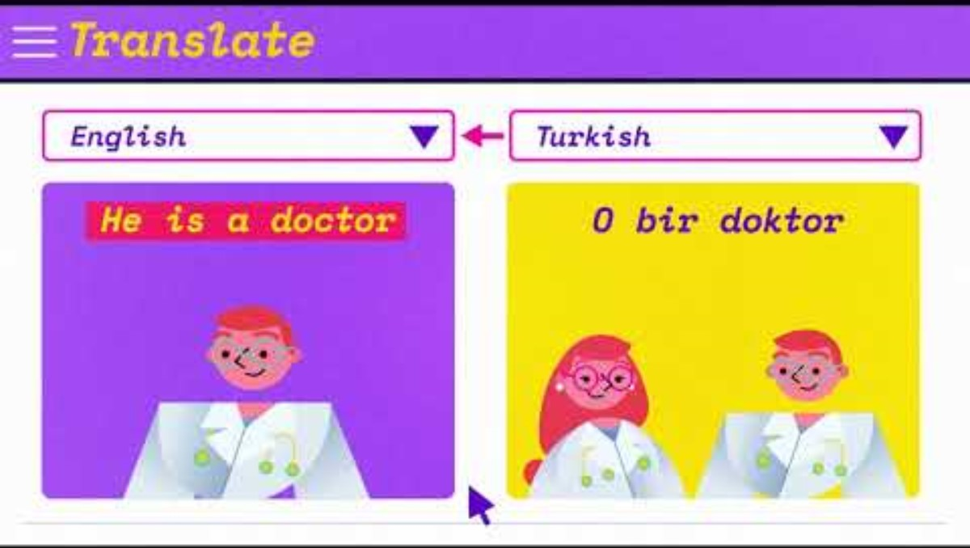
8-minutes video to learn more
Video link

Slide 46
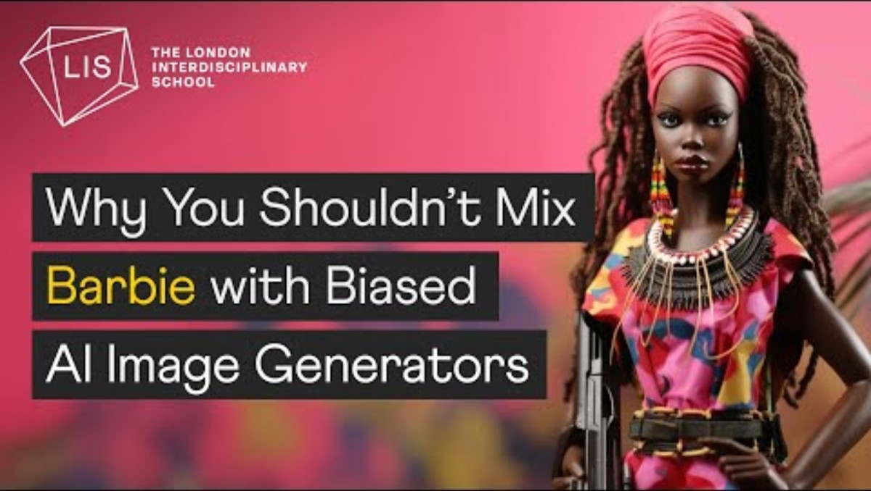
8-minutes video to learn more
Video link

Slide 47
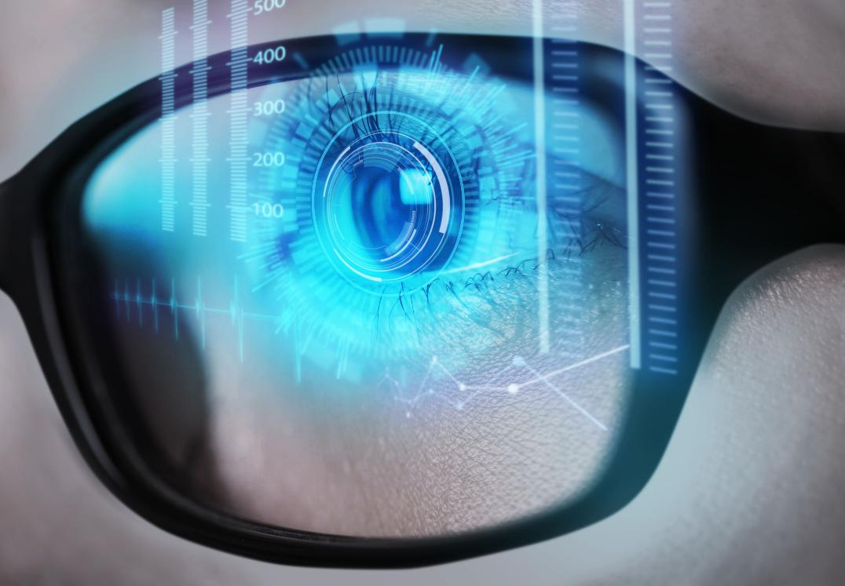
Let’s discuss about our activities

Slide 48
Feedback session
What factors do you think influence the bias in images generated by AI?
Do you think bias in AI is inevitable?
What lessons have you learned from this activity about how AIs ‘understand’ our instructions?
What surprised you the most in the activity?

Slide 49
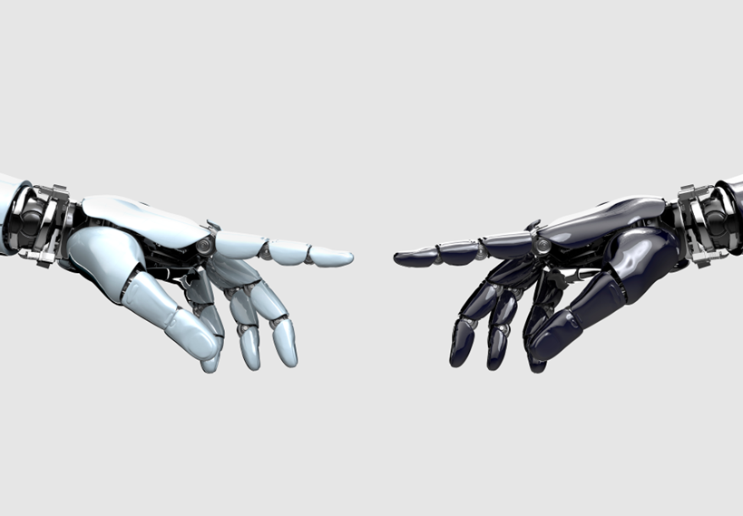
05
Recap and Key terms

Slide 50
Key terms to remember!!
Ethics – Principles that guide decisions about what is right or wrong.
AI Ethics – Ensuring AI is designed and used fairly, transparently, and responsibly.
Bias – Unfair or unbalanced views that can appear in AI due to its training data.
Stereotype – A fixed idea about a group of people that may not be true or fair.
Representation – Who is shown (or missing) in media or AI-generated content.
Prompt – The instruction or question given to an AI tool to generate a response.
Algorithm – A set of rules AI systems follow to make decisions or create content.
Transparency – Clear understanding of how AI makes decisions.
Privacy – Protecting personal data and ensuring it’s used responsibly.

Slide 51

Thank you
Any Questions?
www.headstart-ai.eu

