Slide 1


MODULE 3
Building Confidence with AI Tools
www.headstart-ai.eu

Slide 2
Module overview
This module introduces learners to user-friendly AI tools like ChatGPT and Canva AI. Through hands-on activities, they learn how to use these tools for creativity, communication, and productivity. The session also explores how to identify trustworthy AI-generated content, encouraging learners to think critically and experiment confidently with new technologies.
01
Exploring AI Tools
02
AI for making life easier
03
Identifying Trustworthy Content
04
Building Confidence Through Practice
05
Recap and key terms

Slide 3
By the end of this module, learners will be able to:
Understand what AI tools are and what they can do
Gain confidence using ChatGPT and Canva AI through simple creative tasks
Learn how to evaluate AI-generated content critically
Identify risks like misinformation and bias in AI responses
Feel more comfortable experimenting and learning through doing
Learning Objectives Module 3

Slide 4

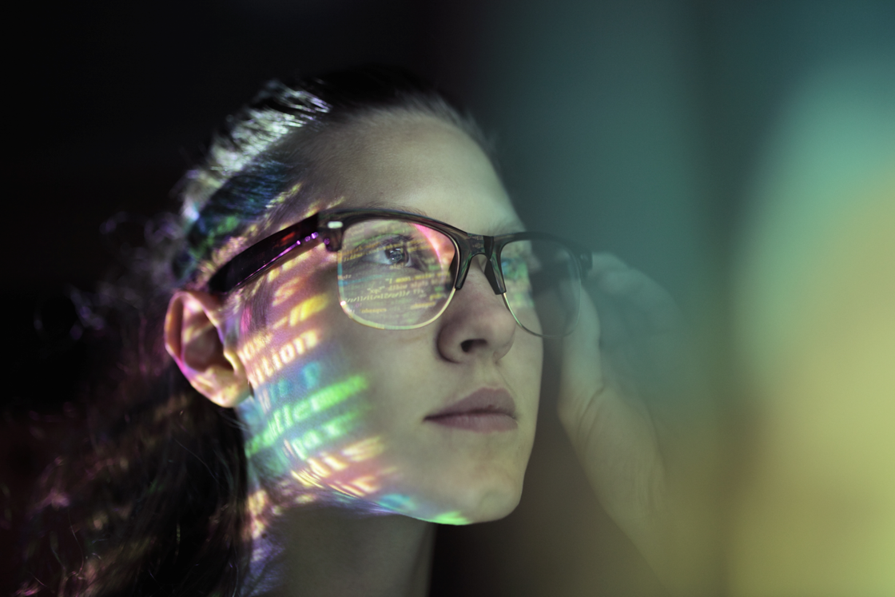
01
Exploring AI tools

Slide 5


Introduction to Basic AI Tools
What are AI tools?
AI tools are software applications that use artificial intelligence to perform tasks such as text generation, image creation, and task automation.
Examples: ChatGPT (text-based AI), Canva AI (design-focused AI).
Why are AI tools important?
Enhance creativity and productivity.
Make complex tasks more accessible and manageable.
Help in problem-solving and idea generation.

Slide 6

What is ChatGPT?
Chat GPT
ChatGPT is a chatbot that uses GPT.
GPT stands for Generative Pre-trained Transformer, which is a type of machine learning algorithm (discussed in Module 1) that uses deep learning & a large database of training text to generate new text in response to a user’s prompt.
GPT is a family of AI models built by OpenAI (an AI research company)
GPT models are designed to generate human-like responses to a GPT prompt. Initially, these prompts had to be text-based, but the latest versions of GPT (GPT-4.5, GPT-4o, and GPT-4o mini) can also work with images and audio inputs because they're multimodal (LMM or SLM)
An Overview

Slide 7
GPT-based tools can do things like:
Answer questions in a conversational manner
Generate blog posts and other kinds of short- and long-form content
Summarise long passages of text
Edit content for tone, style, and grammar
Brainstorm ideas and ideate content structure
Create and analyse images or Write code based on design mockups
Answer questions about charts and graphs
Translate text to different languages

Slide 8

What is Canva AI?
Canva AI
An Overview
Canva AI is an advanced feature within Canva (the user-friendly design platform) where it integrates artificial intelligence to help users create professional-quality visuals with ease and confidence
It uses AI to:
Automate design tasks like resizing and layout suggestions.
Generate content such as text, images, or animations.
Provide templates and design ideas for various needs (e.g., presentations, posters, social media posts).

Slide 9
Canva AI can do things like:
Magic Write: Generate written content within documents or designs.
Background Remover (Premium): Remove unwanted backgrounds from images
Text-to-Image: Create images from text descriptions
Design Suggestions: AI-powered layout recommendations
Customise Your Design - Adjust colours, fonts, and layouts using Canva’s intuitive interface
Choose a pre-made template for a social media post & modify it with your own text & images
Encourage creativity and experimentation without needing prior design experience
One-Click Style Matching - Allows users to apply styles from one design to another

Slide 10

02
AI for Making Life Easier

Slide 11

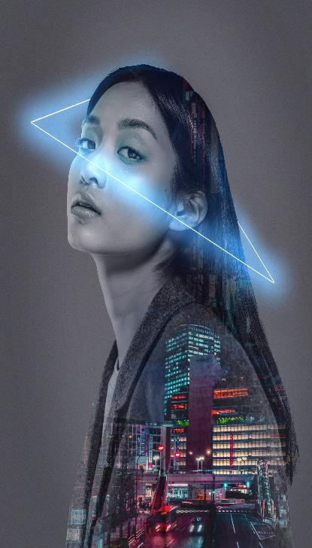
AI for Productivity
Artificial Intelligence is a tool for creativity as well as being a powerful asset for boosting productivity. It helps you get things done faster—like coming up with ideas, sorting tasks, or creating content—so you can spend more time on what matters.
In this section, we will explore how ChatGPT and Canva AI can be used to enhance productivity in everyday tasks, from organising information to designing professional-quality visuals in minutes. By experimenting with these tools, we want you to gain confidence in using AI to simplify workloads, save time, and improve efficiency in academic, personal, and professional projects.

Slide 12
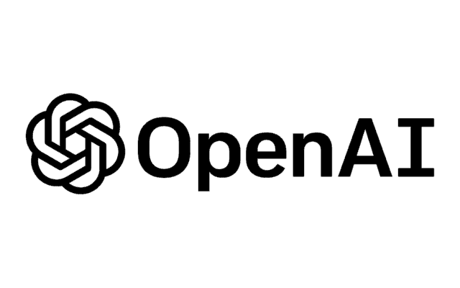
Basic ChatGPT steps of use
Step 1: Craft a Good Prompt
Step 2: Iterating on Responses
Step 3: Experiment with Applications
- Be specific with your request:
General: Tell me about climate change
Specific: Explain the causes of climate change in simple terms for a 12-year-old.
- Ask ChatGPT to perform tasks:
Describe, list, translate, shorten, etc. E.g., Generate 3 creative ideas for a science project
If the first response doesn’t meet your needs, refine your prompt.
E.g., Add more details, Make it shorter, or Focus on...
Learning Tool: Ask for explanations of difficult topics.
Writing Assistant: Use it to draft outlines, essays, summaries.
Creative Tool: Generate poetry, stories, or brainstorming ideas.

Slide 13
Using ChatGPT for smarter work...
Custom Instructions: Personalise ChatGPT’s responses by providing specific business or personal context.
Prompt Engineering: Craft clear prompts to improve ChatGPT's output quality. Use prompt tools
Summarisation: Use ‘TL;DR’ to condense long articles or videos.
Understanding Colloquial Language: Translate slang & idioms with better accuracy than traditional tools.
Reverse Prompting: Provide a fact or idea & ask ChatGPT for supporting evidence.
Sider Extension: Access ChatGPT anywhere with the Sider Chrome extension.
Meeting Transcriptions: Transcribe meetings & extract key points using ChatGPT.
Content Repurposing: Adapt existing content for different formats & platforms.
Networking Assistance: Generate personalised networking messages.
Communication Refinement: Improve clarity & conciseness in written communication.

Slide 14


10 Game-Changing ChatGPT Hacks to Boost Productivity!
​This video presents innovative ways to utilise ChatGPT for enhanced productivity and creativity. These hacks demonstrate ChatGPT's versatility in various professional scenarios, from enhancing communication to streamlining workflows.​
For a visual walkthrough of these hacks, you can watch the full video here:
10 ChatGPT Hacks That Will Blow Your Mind!

Slide 15

Basic Canva AI Steps
Step 1: Choose a Design & Let AI Assist You
Step 2: Enhance Your Content with AI Tools
Step 3: Finalise, Collaborate & Share
Open Canva & select what you want to create (a presentation, social media post, or poster)
Use Magic Design to get AI-powered template suggestions based on your content or uploaded images.
Customise the design by selecting styles, fonts, & colours that fit your vision.
Use Magic Write to generate catchy text (e.g., headlines, captions, or blog content).
Try Text-to-Image AI to create unique visuals from descriptions (e.g., “a futuristic city at night”).
Use Background Remover (Pro feature) to cut out backgrounds in one click & refine your design.
Let AI suggest layout adjustments & formatting improvements.
Use AI-powered translation if creating content in multiple languages.
Download, schedule for social media posting, or collaborate with teammates directly in Canva.

Slide 16
Using Canva AI for smarter work...
Magic Design
Integrating Leonardo AI, this feature enables users to create images directly within Canva, combining image-making and design capabilities in one platform
AI Video Creation
This suite includes tools like Magic Resize, and Magic Eraser, which help to resize designs or remove unwanted elements from images.
This prompt-based graphic design tool allows users to input ideas and instantly generate multiple professional and editable design templates.
Users can create videos using AI prompts, expanding Canva's capabilities beyond static design into dynamic content generation
Dream Lab
Magic Studio

Slide 17
Using Canva AI for smarter work...
Magic Write
This feature automates the animation of design elements, allowing users to create engaging visuals easily
Automatic Highlights
This AI tool simplifies the process of isolating subjects from backgrounds in images for cleaner, more professional designs.
This tool enables users to generate, edit, and adapt text directly within designs, improving efficiency in crafting written content
For video editing, this tool identifies key moments in videos and allows for quick extraction and use
AI Animation
Background Remover

Slide 18
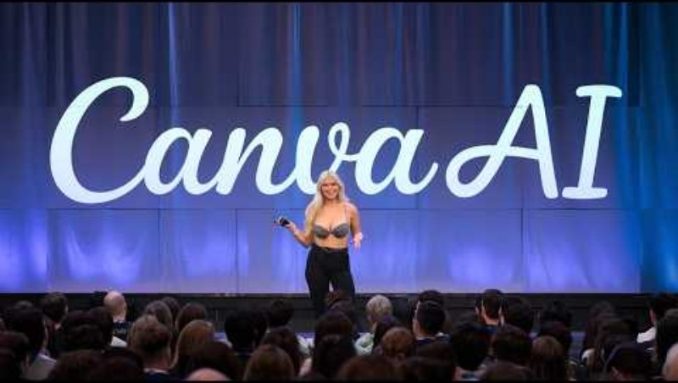
Canva Revolutionises Design!
​This video presents innovative ways to utilise Canva for enhanced productivity and creativity. Canva's new AI tools, streamline the design process, reinforcing Canva's position as a leading design platform​
For a visual walkthrough of these tools, you can watch the full video here:
NEW CANVA AI Revolutionizes Design Forever: Full-Demo

Slide 19
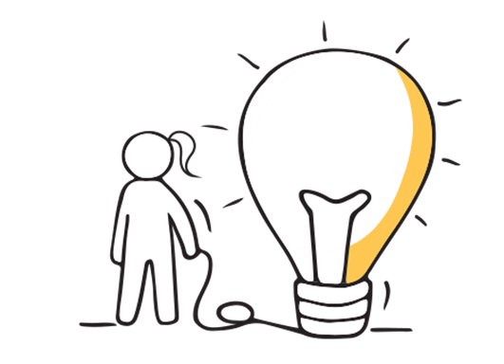
While this module focused on just two tools—ChatGPT & Canva AI—there’s a whole world of other exciting AI tools out there to explore including…
Other Tools
Claude is an AI assistant trained by Anthropic. It stands out for its preciseness in coding tasks and its ‘coaching’ approach or conversations, but like Chat GPT it is a generative AI tool.
DALL-E 3: Open AI trained a neural network called DALL-E that helps users create new images by only using graphic prompts (human text).
Lyric Studio: An AI-powered songwriting tool that helps create lyrics based on the user’s genre or topic.
Synthеsia: An AI vidеo gеnеrator platform whеrе you can gеnеratе profеssional vidеos that are high-quality, scalablе, and affordablе.

Slide 20

03
Identifying Trustworthy Content

Slide 21

Success in creating AI would be the biggest event in human history. Unfortunately, it might also be the last, unless we learn how to avoid the risks

Slide 22

AI tools like ChatGPT can provide quick and insightful responses, but they are not perfect.
AI can generate…
Incorrect Information
Biased Information
Misleading Information
Why Evaluating AI-Generated Content is Important…
Assessing AI-generated content's reliability is crucial to making informed decisions and avoiding misinformation.

Slide 23
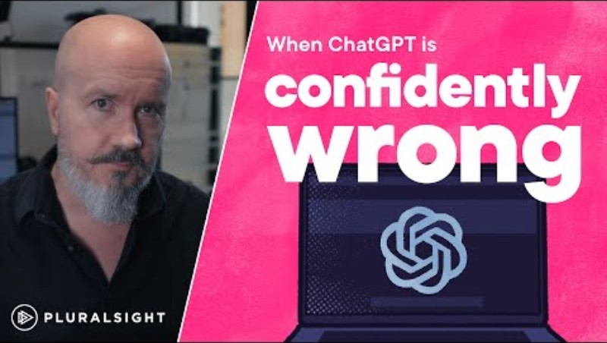
Incorrect Information in AI…
ChatGPT can generate convincing but incorrect information, especially in technical contexts. Users must be cautious, as it may provide realistic-sounding answers that are entirely fabricated. Relying on ChatGPT without verification can lead to significant misinformation and credibility issues.
Watch this video for an example of when it is confidently wrong:
When ChatGPT is confidently wrong

Slide 24
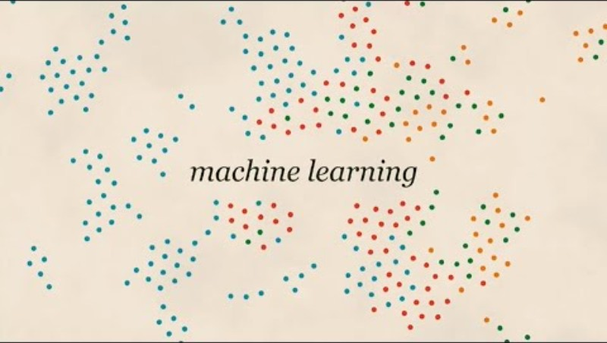
Bias Information in AI…
​Bias in AI arises from human influence during machine learning, affecting technology like image recognition. Three types of bias include interaction bias, latent bias, and selection bias. Addressing these issues requires awareness and collective effort to ensure technology serves everyone fairly and does not perpetuate negative biases.
Watch this video for an explanation:
3 types of bias in AI | Machine learning

Slide 25
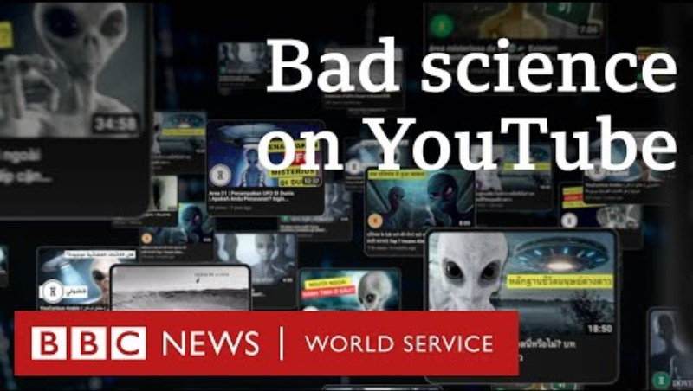
Misinformation Information in AI…
This video highlights the growing problem of AI-generated "bad science" videos on YouTube, which target children with false information and misinformation, often beating legitimate science content in the algorithm
Watch the video here made by the BBC Global Disinformation team:
Bad science: AI used to target kids with disinformation on YouTube - BBC World Service

Slide 26
Key Factors for Evaluating Trustworthy Content
Source Verification
Fact Checking
Bias & Objectivity
Up-to-Date Information.
Consistency Across Sources
Ask: Where is the information coming from?
Cross-check facts with reliable sources (government websites, academic papers)
Compare AI-generated responses with other credible sources.
Use fact-checking websites like FactCheck.org, or Reuters Fact Check to verify claims.
AI learns from data, which may contain biases.
Be aware of one-sided answers
Ask AI for multiple perspectives on a topic to identify potential biases
AI knowledge may not include recent developments
For current events, always consult news sources, official reports, or research articles
If multiple sources provide the same information, it is more likely to be accurate.
If AI-generated content contradicts facts, investigate further

Slide 27
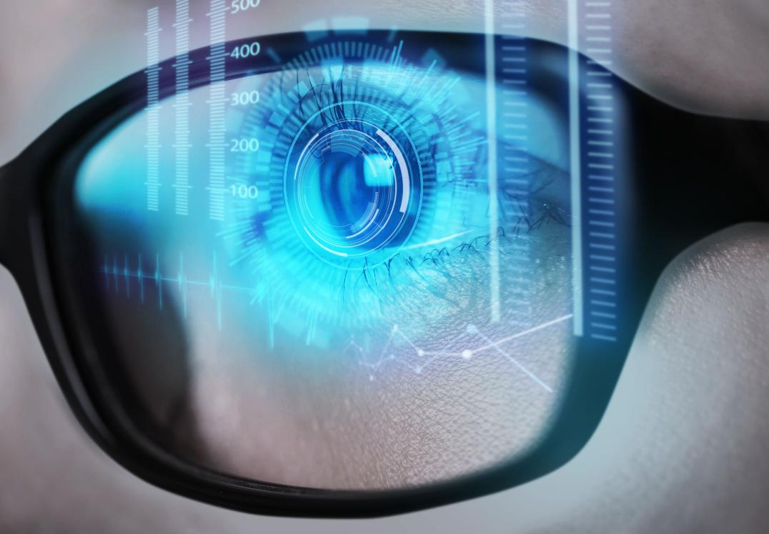
04
Building Confidence Through Practice

Slide 28
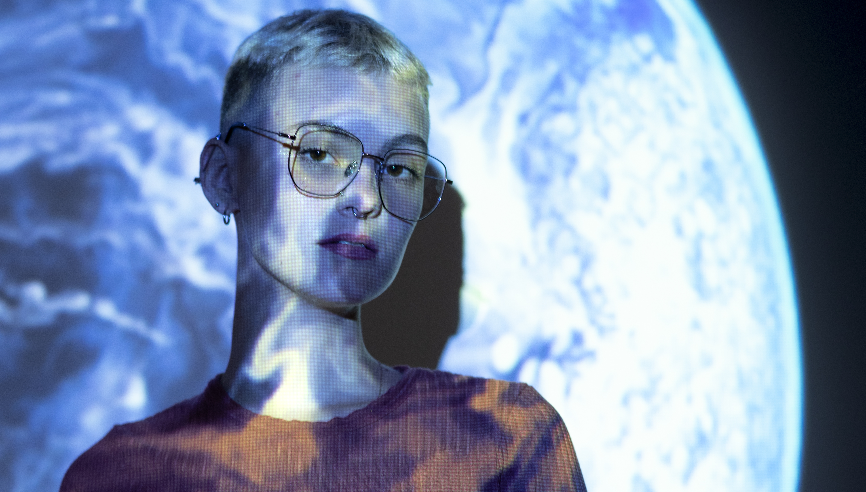
Practice makes perfect!
Objective: Help learners understand AI’s ability to adapt and generate creative variations.
Instructions:
Ask ChatGPT to generate a short story (e.g., “Write a short fairytale about a girl who discovers an AI-powered book.”).
Experiment by tweaking the prompt, asking for:
  A different genre (e.g., "Rewrite this as a mystery.")
  A different character perspective (e.g., the story from the AI book’s point of view.")
  A surprise plot twist (e.g., "Add a futuristic setting.")
✅ Demonstrates how adjusting inputs & prompts change AI outputs, making learners feel in control of the tool.
ACTIVITY
AI-Powered Story Remix Challenge

Slide 29


Practice makes perfect!
Objective: Help learners enhance their creativity and confidence in using Canva AI for design & content creation.
Instructions: Select and carry out one of these activities
Magic Write: “Generate three taglines for a women’s empowerment event.”
Text-to-Image: “Create an abstract design with vibrant colours for a digital poster.”
Template Customisation: Choose a pre-made template for an Instagram post and modify it with your own text and images.
✅ Demonstrates how Canva AI enhances creativity, efficiency, and personalisation, and can be time-saving.
ACTIVITY
Experimenting with Prompts for Canva AI

Slide 30
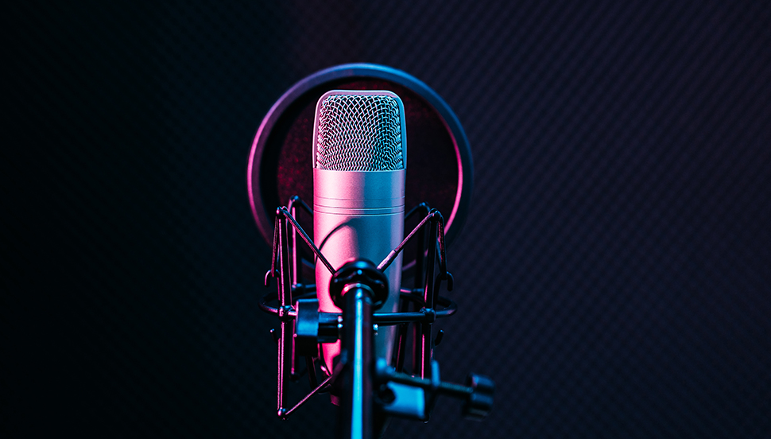
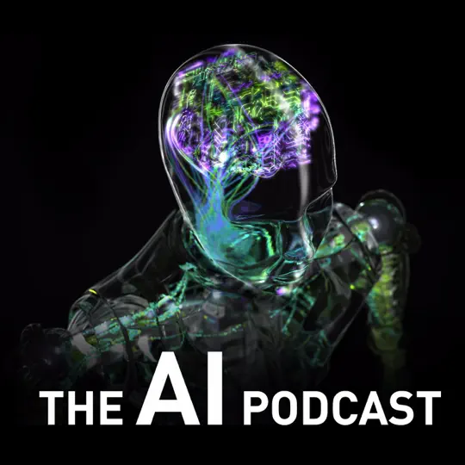

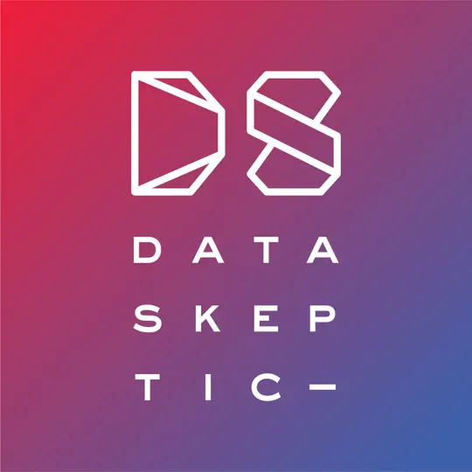
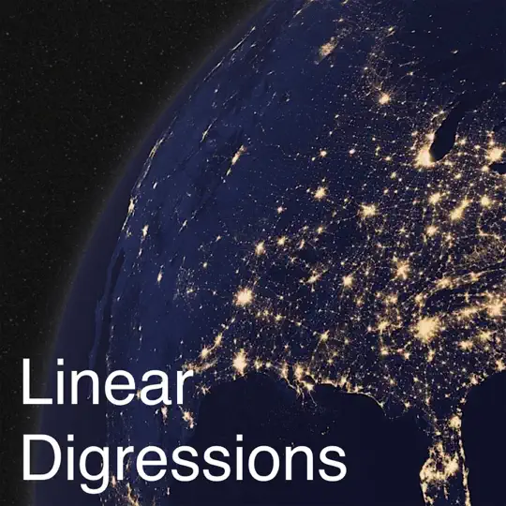
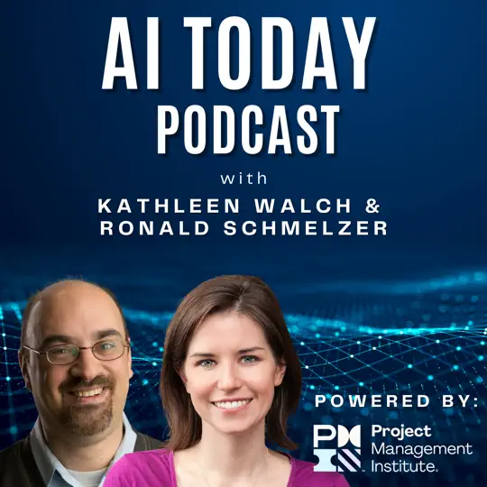
Some podcast series that might be of benefit to follow…
Tools to Help
Podcasts

Slide 31

The key to artificial intelligence has always been the representation

Slide 32

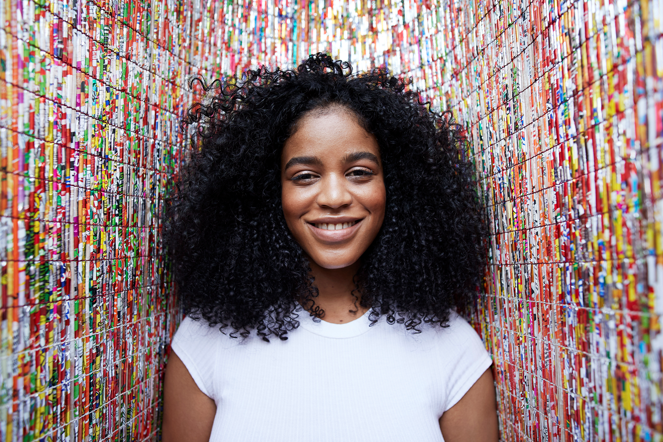
05
Recap and key terms

Slide 33
Key terms to remember!!
Artificial Intelligence (AI) – Technology that enables computers to think and learn like humans.
Generative AI (GenAI) – AI that creates new content like text, images, music, and videos.
Machine Learning (ML) – A subset of AI where machines learn from data without being explicitly programmed.
Neural Networks – AI models inspired by the human brain, used for processing data and making decisions.
Generative Adversarial Networks (GANs) – AI models where two neural networks compete to create realistic images and videos.
Transformers – AI models used in chatbots, language translation, and text generation (e.g., ChatGPT).
Deep Learning – A type of machine learning that processes complex data using multiple layers of neural networks.
Natural Language Processing (NLP) – AI’s ability to understand and generate human language (e.g., Siri, Alexa, ChatGPT).

Slide 34

Well Done!!!
You have just completed Module 3…keep going on your learning journey…Module 4 discusses
AI in the Job Market: Skills for Success
www.headstart.eu

