Slide 1


MODULE 4
AI in the Job Market:
Skills for success
www.headstart-ai.eu

Slide 2
Module overview
01
Why AI?
To provide you all with
a comprehensive understanding of how Artificial Intelligence (AI) is reshaping the job market and give you tools and inspirations to leverage AI for personal and professional success.
02
AI in careers
03
Stereotypes
04
Entrepreneurship and AI
05
Recap and key terms

Slide 3
By the end of this module, learners will be able to:
Understand how AI is transforming different industries and job roles
Recognise how AI-related skills support creativity, employability, and entrepreneurship
Identify and challenge gender stereotypes in tech and AI
Learn from real women working in AI and explore how values-based prompts can promote fairness and inclusion
Explore how AI can be used to support or grow a business idea
Learning Objectives Module 4

Slide 4


01
Why AI?

Slide 5
Why Should This Matter To Me?
AI changes the way we work and directly impacts several industries.
It is important that we learn to work with AI, know its benefits, but also know its risks.
Did you know that when you get a job you'll probably work with AI?

Slide 6

Let’s chat:
How do you think AI is influencing jobs nowadays?

Slide 7

02
AI Careers

Slide 8


Industries and AI
Artificial Intelligence (AI) is revolutionising industries worldwide, becoming integral to various sectors and professions.
For girls and young women, acquiring AI-related skills opens diverse career opportunities, empowering them to be at the forefront of innovation and leadership in the evolving workforce.

Slide 9
In marketing, e-commerce and advertising, it is possible to use these tools to create campaigns, images, videos and new ways of engaging with your audience.
Digital Marketing

Slide 10
AI is being explored as a tool to accelerate the discovery of new medicines and improve patient health records.
AI helps doctors detect diseases early by analying medical images.
Robots assist surgeons in operations with precision.
AI-powered chatbots provide medical advice.
Health

Slide 11
Tools that allow you to design personalized learning plans for each student, suited to their needs and learning styles.
Personalised learning apps (e.g., Duolingo) adapt to the pace of each student.
AI translates languages ​​instantly, connecting students worldwide.
Tools like AI tutors help kids learn math, science, and even coding!
Education

Slide 12
Tools that analyse behavior patterns and anticipate trends in the stock market.
Finance

Slide 13
AI predicts weather patterns and helps tackle climate issues.
It helps reduce energy waste in cities.
AI-driven projects protect endangered species by analysing data from the wild.
Environment and climate change

Slide 14
AI designs clothing and predicts what’s trendy.
Virtual fitting rooms allow you to "try on" clothes online.
Stores use AI to recommend products you might like.
Fashion and retail

Slide 15
Tools that allow you to write code more efficiently, as well as review code quickly, suggesting ways to resolve bugs.
Software development

Slide 16
AI tools allows you to plan, draft and review written work.
Writing

Slide 17
Chatbots, Voicebots and virtual assistants allow you to reduce response time and answer quickly to frequently asked questions.
Customer service

Slide 18

Let’s share
Which industry excites
you the most and why?

Slide 19
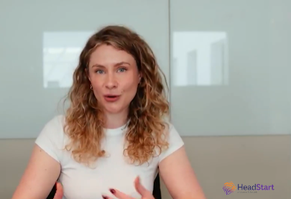
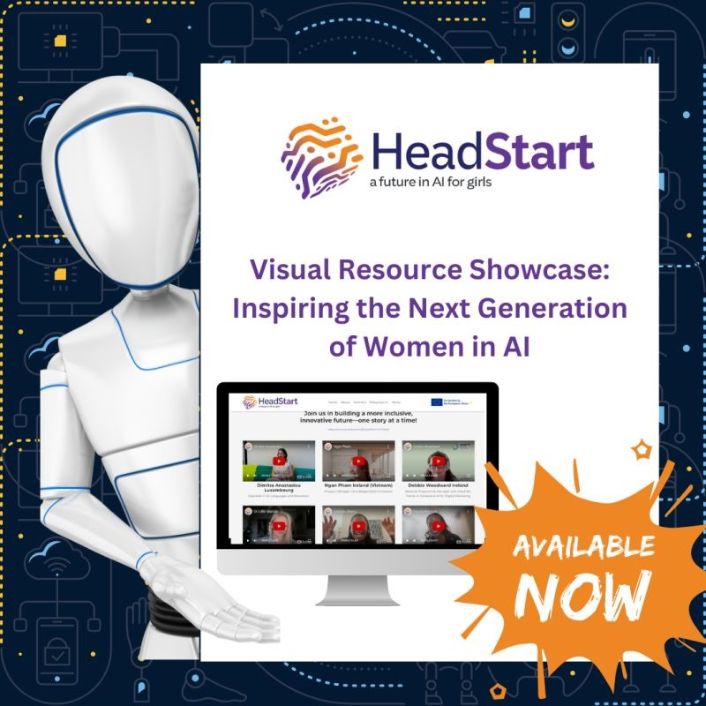
Line Noergaard
Manager in NewTech, KPMG, Denmark
Let’s watch a short interview with a woman in an AI-related role and discuss the skills she uses daily.
01
Watch
it here!
Activity

Slide 20


03
Sterotypes

Slide 21


Breaking stereotypes
For many years, technology fields like AI were seen as "for boys" because of cultural stereotypes and a lack of visible female role models;
These stereotypes suggest that: Girls aren’t good at math, science, or coding;
Tech jobs are boring or don’t fit with creative or social interests.

Slide 22

AI isn’t just for programmers - it’s for anyone who wants to solve problems, whether they love animals, art, or helping people.
AI is a tool that can be used to make the world a better place, and their ideas and creativity are essential to shaping the future.

Slide 23

You Belong Here!
Your unique perspective as a girl can bring fresh ideas to the table...
AI needs YOU!

Slide 24

What happens when
AI lacks in diversity?
If a group of only men designs a voice assistant, they might forget to include features that women could find useful.
AI systems for hiring have shown bias because they were trained using data from mostly male applicants.

Slide 25
More voices mean
fewer blind spots.
Having women in AI helps create better tools
for women.
A diverse team can spot and fix these biases, making the AI fairer for everyone.

Slide 26

Dream Big
AI for a Better World

Slide 27
AI for good: Projects tackling climate change, education, and healthcare
We need to empower YOU to dream about leading these innovations!
AI Can
Change Lives

Slide 28
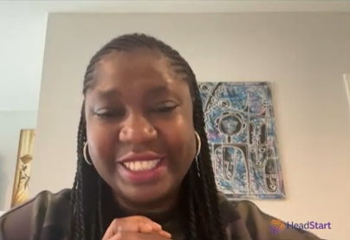
Adebola Olomo Ireland (Nigeria)
CEO, Deeferent Marketing Agency, Technology Adoption Consultant | Author, Marketing with AI.
02
Watch
it here!
Let’s watch another interview with a woman in an AI-related role and discuss the skills she uses daily.
Activity

Slide 29
BE READY
Keep a lifelong learning mindset
Be AI-curious
Learn
digital skills
Keep up with
AI trends

Slide 30

Power of Prompts
Fighting Bias in AI

Slide 31

Power of prompts
AI doesn’t think for itself - it learns from the data we give it.
If the data has bias (like stereotypes about gender, race, or culture), the AI might accidentally repeat those biases in its answers...

Slide 32

Power of prompts
If an AI was trained on stories where only men are scientists, it might think only men can do science. But we know that’s not true! Women and girls can - and do - achieve amazing things in science, technology, and AI.
By asking the right prompts, you can guide the AI to challenge stereotypes and create fairer answers.

Slide 33
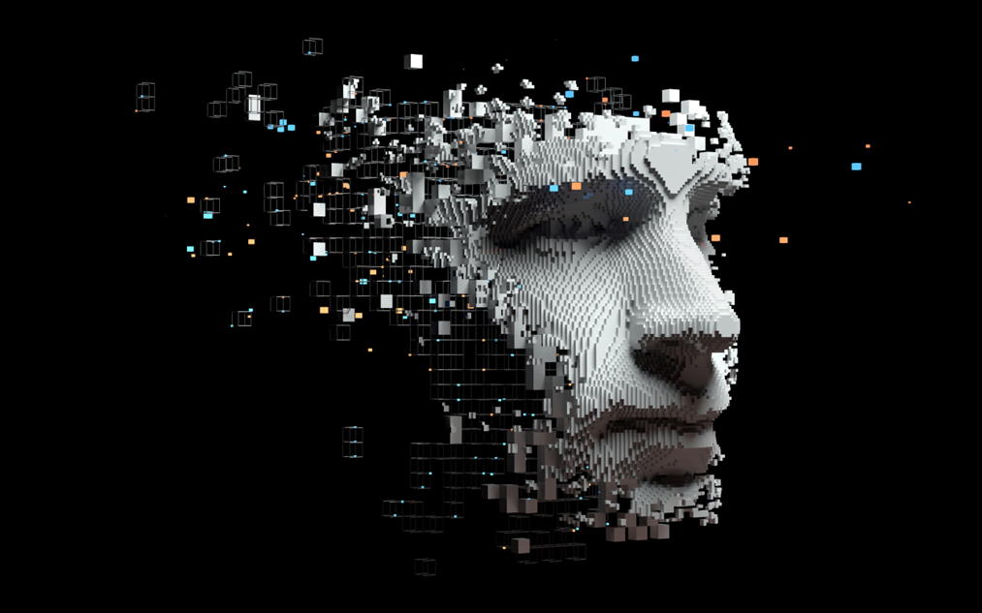
Prompts helps you teach AI to think in a more balanced way.

Slide 34
Challenge: Create Your Own Prompt
Think of a way to teach an AI about diversity and fairness.
Here are some ideas:
“Write a story where the main character is a girl who becomes a robotics engineer.”
“List five inspiring women from different countries who work in AI.”
“Explain why diversity in AI teams makes technology better.”
Try your prompt and see how
the AI responds!
03
Activity
Script here!

Slide 35
You make AI …
SMARTER
MORE
INCLUSIVE
KINDER
Everytime you:
Highlight amazing women in history,
Include stories from different cultures,
And use language that celebrates diversity...
You’re helping create AI that represents everyone, not just a few voices.

Slide 36
04
Entrepreneurship and AI

Slide 37

AI is like a super-smart helper for businesses!
It can do things faster, smarter, and sometimes even better than humans - helping companies grow and succeed.

Slide 38
You could use AI to start your own company and bring your ideas to life!
Saves time by doing repetitive tasks
Helps make smart decisions
Creates special experiences for customers
Comes up with cool ideas
Saves money

Slide 39
Brainstorm
Come up with a business idea and explore how AI could support it.
04
Activity
Script here!

Slide 40
The world needs your creativity, your perspective, and your ideas.
Together, we can prove that tech isn’t just for boys or nerds - it’s for everyone. And who knows?
You might create
the next AI breakthrough
that changes the world!

Slide 41
05
Key terms

Slide 42
Key terms
Artificial Intelligence (AI)- A type of technology that allows computers and machines to learn, solve problems, and make decisions like humans.
AI Skills- Abilities that help people work with AI tools, such as writing prompts, analysing data, or using AI in creative or business tasks.
Job Market- The world of work, including the types of jobs available and the skills employers are looking for.
Bias- When decisions or results are unfair due to stereotypes or unbalanced data. AI can learn bias if it is trained on biased information.
Stereotypes- Oversimplified ideas about people, such as “only men work in tech” – these can influence how AI behaves if not challenged.
Prompt-A question or instruction you give to an AI tool to get a response. The quality of your prompt can affect the fairness and accuracy of the answer.
Entrepreneurship- The process of starting and running your own business – AI can help by saving time, analysing data, and creating content.
Digital Tools- Online apps or platforms that use technology (including AI) to help people work, learn, or create.
Innovation- Coming up with new ideas or ways of doing things, especially with the help of technology like AI.
Diversity- Including people from different backgrounds, cultures, and experiences. Diversity in AI teams leads to better, fairer technologies.

Slide 43

Thank you
Any Questions?
www.headstart.eu

