Slide 1
MODULE 5
Artificial Intelligence for social good
www.headstart-ai.eu

Slide 2
Module Overview
01
What’s beyond AI’s negative reputation
02
AI for sustainability
This module introduces learners to the positive impact AI can have on people, communities, and the planet. Through real-world examples, creative tasks, and inspiring role models, learners explore how AI is used in areas like sustainability, healthcare, and accessibility. The module also highlights the role of women in AI and encourages young people to think critically, work collaboratively, and design their own ideas for using AI to solve social challenges.
03
AI in healthcare
04
AI for Inclusion and Accessibility
05
Recap and key terms

Slide 3
By the end of this module, learners will be able to:
Explore both the risks and benefits of AI, and challenge common misconceptions.
Identify how AI supports sustainability through climate prediction, conservation, and waste reduction.
Describe how AI is used in healthcare for prevention, diagnosis, treatment, and mental health support.
Understand how AI promotes inclusion and accessibility for people with different abilities and needs.
Recognise inspiring women using AI for good and reflect on their own potential to make a difference.
Work creatively and collaboratively to design or pitch an AI-for-good solution.
Learning Objectives Module 5

Slide 4
01
What’s Beyond AI’s negative reputation

Slide 5
When YOU think about AI, what have you heard? Is it good? Is it bad?
Think of examples from both sides of the spectrum.

Slide 6
WATCH
Maybe it is time to look at AI through a new lense?

Slide 7
02
AI for sustainability

Slide 8
Climate change is one of the most important challenges of our time, and AI offers innovative solutions to help combat it.
AI algorithms can analyse climate data from around the world, predicting trends and helping scientists understand the impacts of various environmental factors. For instance, AI can forecast extreme weather events, allowing communities to prepare in advance and minimise damage.
Young women can get involved by learning how AI models predict carbon emissions and identify the most effective strategies for reducing them.
AI and Climate change

Slide 9
Examples of AI for monitoring climate
Get to know Climate TRACE — a global nonprofit coalition using satellites, other remote sensing techniques, and artificial intelligence to deliver a detailed look at global emissions. Climate TRACE makes meaningful climate action faster and easier by mobilizing the global tech community to track emissions with unprecedented detail and speed and provide these data freely to the public.

Slide 10
Wildlife conservation is another area where AI is making a significant difference. AI-powered tools monitor endangered species, track poaching activities, and restore natural habitats.
For example, AI can process images from camera traps to identify animals, monitor their movements, and assess the health of ecosystems without disturbing them.
Young women interested in wildlife can explore AI projects that contribute to conservation efforts. You can learn to build simple AI models that recognise different animal species or analyse data from sensors placed in forests or oceans.
AI-Powered Conservation Efforts

Slide 11
Examples of AI in conservation efforts
Wildbook is an open source, evolving platform for wildlife research. It supports field biologists in collecting more wildlife data through citizen science, applies A.I. to speed curation and find hidden trends, and securely shares data between groups dedicated to species conservation. Wildbook is a critical innovation that fosters new partnerships of intelligent machines and mankind working together to protect our dwindling wildlife and prevent a “sixth mass extinction”.

Slide 12
The waste problem is growing worldwide, but AI offers promising solutions to manage and reduce it. AI systems can optimise waste collection routes, identify recyclable materials, and even sort waste more efficiently than humans.
These technologies are crucial for reducing the environmental impact of waste and promoting a circular economy.
Young women can participate by creating AI-driven projects that focus on waste management. For instance, YOU can use image recognition to develop AI models that categorise waste into recyclables and non-recyclables.
AI in Waste Management and Recycling

Slide 13
Examples of AI in waste management
Bin-e is an AI-based smart waste bin, designed for public places, enabling them to simplify recycling. It sorts and compresses the waste automatically, controls the fill level and processes data for convenient waste management.

Slide 14
Take 10 minutes now and brainstorm ideas in groups of how AI can be used in sustainability efforts

Slide 15
03
AI in
Healthcare

Slide 16
Lets look at AI role in healthcare
AI is getting increasingly sophisticated at doing what humans do, but more efficiently, more quickly and at a lower cost. The potential for both AI and robotics in healthcare is vast. Just like in our every-day lives, AI and robotics are increasingly a part of our healthcare eco-system.

Slide 17
Lets look at AI role in healthcare
AI is getting increasingly sophisticated at doing what humans do, but more efficiently, more quickly and at a lower cost. The potential for both AI and robotics in healthcare is vast. Just like in our every-day lives, AI and robotics are increasingly a part of our healthcare eco-system.

Slide 18
One of AI's biggest potential benefits is to help people stay healthy so they don't need a doctor, or at least not as often. The use of AI and the Internet of Medical Things (IoMT) in consumer health applications is already helping people.
Technology applications and apps encourage healthier behaviour in individuals and help with the proactive management of a healthy lifestyle. It puts consumers in control of health and well-being.
Additionally, AI increases the ability for healthcare professionals to better understand the day-to-day patterns and needs of the people they care for, and with that understanding they are able to provide better feedback, guidance and support for staying healthy.
Keeping healthy
Notes:
https://www.pwc.com/gx/en/industries/healthcare/publications/ai-robotics-new-health/transforming-healthcare.html

Slide 19
AI is already being used to detect diseases, such as cancer, more accurately and in their early stages. According to the American Cancer Society, a high proportion of mammograms yield false results, leading to 1 in 2 healthy women being told they have cancer. The use of AI is enabling review and translation of mammograms 30 times faster with 99% accuracy, reducing the need for unnecessary biopsies.
The proliferation of consumer wearables and other medical devices combined with AI is also being applied to oversee early-stage heart disease, enabling doctors and other caregivers to better monitor and detect potentially life-threatening episodes at earlier, more treatable stages.
Early detection
Notes:
Wired (2016). http://www.wired.co.uk/article/cancer-risk-ai-mammograms
https://www.pwc.com/gx/en/industries/healthcare/publications/ai-robotics-new-health/transforming-healthcare.html

Slide 20
Beyond scanning health records to help providers identify chronically ill individuals who may be at risk of an adverse episode, AI can help clinicians take a more comprehensive approach for disease management, better coordinate care plans and help patients to better manage and comply with their long-term treatment programmes.
Robots have been used in medicine for more than 30 years. They range from simple laboratory robots to highly complex surgical robots that can either aid a human surgeon or execute operations by themselves. In addition to surgery, they’re used in hospitals and labs for repetitive tasks, in rehabilitation, physical therapy and in support of those with long-term conditions.
Example
Treatment
Notes:
https://www.pwc.com/gx/en/industries/healthcare/publications/ai-robotics-new-health/transforming-healthcare.html

Slide 21
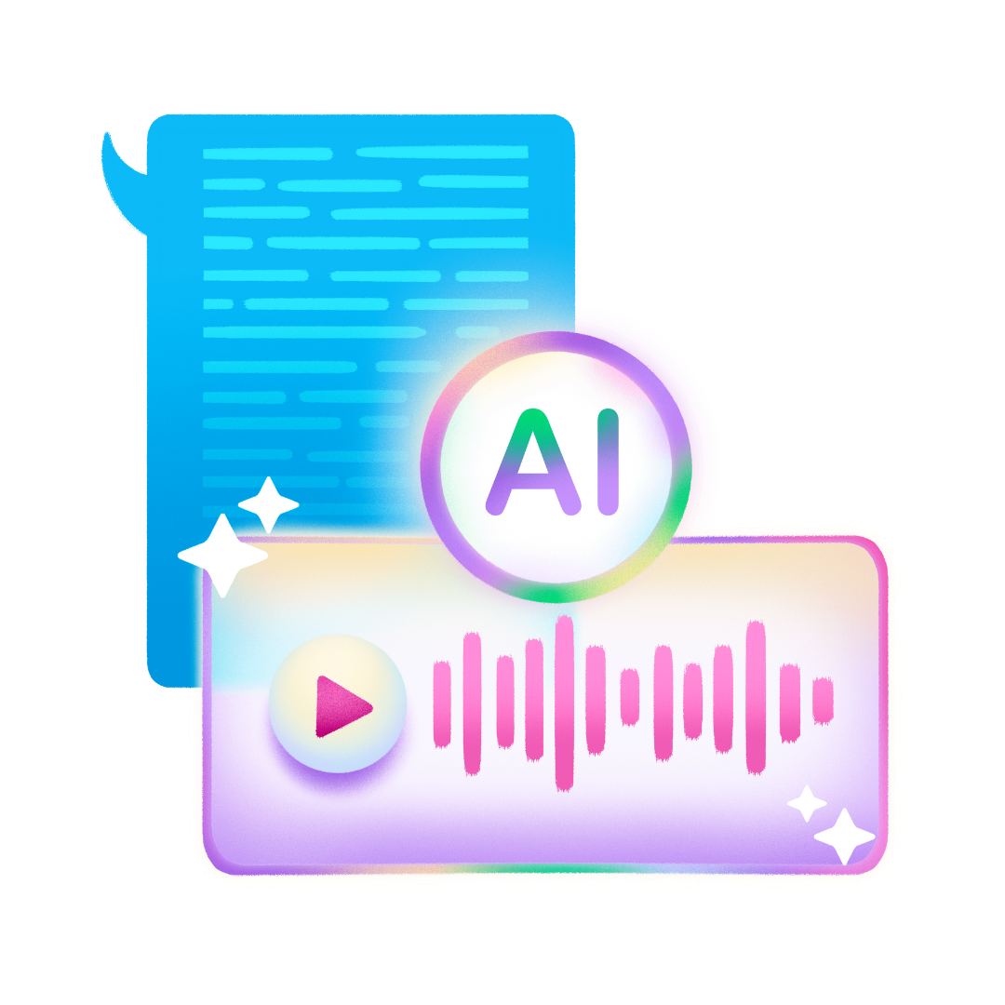
AI applications in mental health range from diagnostic tools to therapeutic interventions.
Machine learning algorithms can evaluate large datasets to identify patterns and predict mental health issues, while AI-powered chatbots offer real-time emotional support and counselling. For instance, AI can analyse text data from social media posts or online interactions to identify signs of depression or anxiety.
Computer vision can analyse facial expressions and body language to detect emotional states, while predictive analytics can forecast potential mental health crises based on historical data.
In next slide we have examples of how AI technology is treating mental health….
Role in Mental health
Notes:
https://www.jetlearn.com/blog/ai-and-mental-health-tools

Slide 22
E.g. Chatbots and Virtual Therapists
AI chatbots have been designed to provide emotional support, cognitive-behavioural therapy (CBT) techniques, and mindfulness exercises.
Virtual therapists can simulate human interactions, providing a sense of companionship and understanding.
These AI tools can help users express their feelings, explore coping mechanisms, and receive guidance in managing their mental health. The anonymity and accessibility of chatbots make them particularly appealing to young people who may be hesitant to seek traditional therapy.
Wysa, developed by Touchkin, is an AI-based emotionally intelligent mobile chatbot app aimed at building mental resilience and promoting mental well-being using a text-based conversational interface.

Slide 23
Take 10 minutes now and brainstorm ideas in groups of how AI can be used in health care

Slide 24
04
AI in promoting Inclusion and accessibility

Slide 25
04
AI in promoting Inclusion and accessibility

Slide 26
Technology should work for everyone, no matter their background, ability, or language. AI is making this more possible.

Slide 27
For people with disabilities
Many AI tools remove barriers between people with disabilities and what they want or need to do. For instance, AI-powered speech recognition software can help people with limited mobility move around or control devices. Likewise, prosthetics and exoskeletons may use AI to be more intuitive and responsive.
AI supports communication, as it helps translate thoughts and feelings into words, even if the person using it communicates differently. Think of things like predictive text and language processing tools, which can generate speech from text or symbols.

Slide 28
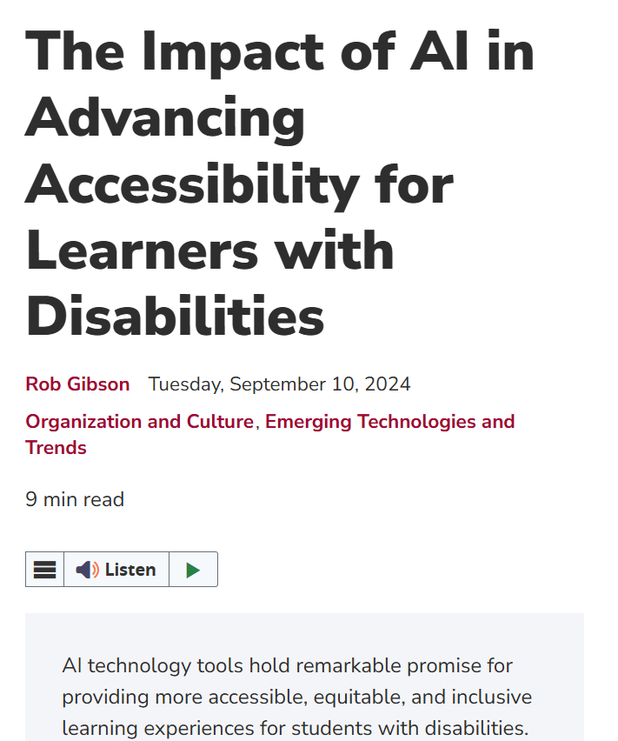
Use voice-activated devices as personal assistants
If your mobility is limited, try using voice-activated AI assistants like Amazon’s Alexa or Siri. A few words are all it takes to control lights, appliances, locks, thermostats, etc.
Use AI to make reading, writing, and learning easier
If you have visual impairments, applications like Microsoft’s Immersive Reader use AI to adjust text size, read text aloud, and provide visual aids when you’re reading.
Use AI to monitor health changes
The AI in things like smartwatches helps you keep track of things like sleep data or your heart rate. This information can be passed on to healthcare providers or used to help you adjust your routines.
Examples
READ
Notes:
https://neuronav.org/self-determination-blog/how-ai-can-help-people-with-disabilities

Slide 29
For people who speak different languages
You’re probably quite aware that the number one barrier that people think of when they reflect on cultural differences is languages–and there’s a good reason why. If the simple ability of a person to communicate is complicated by language barriers, it’s hard to even get the most basic language across.
AI translators like Google Translate or DeepL help people understand schoolwork, documents, and even jokes in another language.
Notes:
https://www.ironhack.com/gb/blog/ai-s-role-in-multilingual-communication-breaking-language-barriers

Slide 30
For students with learning difficulties
Neurodiversity encompasses a wide range of conditions, including autism, ADHD, dyslexia, dyspraxia, and dyscalculia. It's estimated that around 15-20% of the population in Europe are neurodivergent.
Estimates suggest that between 9 and 12% of the European population experiences dyslexia, meaning millions of people across the continent may have this specific learning difference.
Tools like Microsoft Immersive Reader break down text into easier chunks and read it aloud.
Personalised learning companions e.g. Khanamigo (see video), shaped by adaptive algorithms, foster a supportive skill and knowledge development environment.
Notes:
https://school-education.ec.europa.eu/en/learn/courses/etwinning-inclusion-example-neurodiversity-classrooms#:~:text=Scientific%20studies%20show%20that%20around,span%20to%20astounding%20spontaneous%20creativity.
https://reciteme.com/news/neurodiversity-and-online-barriers/

Slide 31
Take 10 minutes now to research Apps, software, hardware or projects that utlise AI for contributing towards accessibility and Inclusion

Slide 32
05
Girls and Women Using AI for Good

Slide 33
Joy Buolamwini – Fighting bias in AI
Joy is a computer scientist who noticed that facial recognition software worked poorly on people with dark skin – especially women. She started a project called the Algorithmic Justice League to expose and fix these issues. Thanks to her work, big companies have had to change their systems.
WATCH
Notes:
https://www.ted.com/talks/joy_buolamwini_how_i_m_fighting_bias_in_algorithms?language=en

Slide 34
Fei-Fei Li – AI for good in healthcare and education
Fei-Fei is a leader in AI research and helped create image recognition systems. But she also leads projects that bring AI to schools and use it to solve social problems – not just business ones.
WATCH

Slide 35
Abeba Birhane – Ethics and fairness in AI
Abeba is a cognitive scientist from Ethiopia, who studied her PHD at University College Dubin. Abeba studies how AI systems reflect social values – and how they can sometimes make harmful assumptions. She pushes for AI to be built in ethical, inclusive ways.
WATCH

Slide 36
Sara Menker – Gro Intelligence is Fighting World Hunger with Tech
Sara Menker was included on Time’s list of the hundred “most influential people” for her work as founder and CEO of Gro Intelligence. The technology company, launched in 2014, uses AI to analyse and forecast agricultural activity around the world — yielding insights on everything from the effect of El Niño on the Ivory Coast’s cocoa harvest to the global price disparity between palm and soybean oil. Its goal is to tackle the challenge of world hunger in the age of climate change, helping decision-makers build more resilient food and economic systems.
WATCH
Notes:
https://magazine.columbia.edu/article/how-gro-intelligence-fighting-world-hunger-tech

Slide 37
ACTIVITY…Option 1: Inspire & Create – AI Changemakers Poster
Objective of the activity is;
To explore the work of women using AI for social good and reflect on how learners could apply similar thinking in their own lives.
1. Choose one woman featured in the slides (Joy, Fei-Fei, Abeba, or Sara), or research another inspiring woman working with AI.
2. In pairs or small groups, design a simple “AI Changemaker Poster” (can be digital or on paper) that includes:
Her name and role
The problem she’s solving with AI
Why her work is inspiring
One idea for how you would use AI for good if you had the chance
Notes:
Output -Posters can be shared in a short group gallery walk or quick presentations. This also supports digital storytelling or visual thinking if you're using Canva or Jamboard.
Why it works- It builds connection, celebrates female role models, and gives learners a low-pressure way to imagine themselves as part of the AI space.

Slide 38
ACTIVITY…Option 2: Pitch Your AI for Good Idea
Objective of the activity is;
To help learners see themselves as potential creators, not just consumers, of AI technologies that help people and communities.
1. Learners form small teams (2–4 people).Each team brainstorms a problem they care about – this could relate to the environment, education, wellbeing, or equality.
2. They come up with an idea for an AI-powered solution to that problem. Prompt questions:
Who does it help?
What does the AI do?
How is it different from what exists already?
3.Optional- Use a simple canvas/worksheet with sections for:
ProblemTarget group
AI tool/approach
Desired impact
4.Teams pitch their ideas in 2–3 minutes. (Can be verbal, sketched, or visual if online.)
Notes:
Why it works
This activity empowers young women to connect their personal values to technology, and practice pitching or presenting — key skills in digital careers.

Slide 39
06
Key Terms

Slide 40
Key terms to remember!!
AI (Artificial Intelligence)-Technology that allows machines to mimic human thinking and decision-making.
Sustainability- Using resources in a way that protects the planet for future generations.
Climate Modelling- Using data and AI to predict future weather patterns and environmental changes.
Wildlife Conservation- Protecting animals and nature – often supported by AI tools to track species and monitor habitats.
Waste Management- Handling rubbish and recycling. AI helps sort waste and reduce pollution.
Internet of Medical Things (IoMT)- Smart health devices (like watches or sensors) that collect data to support better healthcare.
Early Detection- Finding signs of illness early, often using AI to scan images or track health data.
Mental Health Chatbot- AI tools that offer support or coping strategies for emotional wellbeing.
Inclusion- Making sure everyone has access, no matter their background, ability, or language.
Accessibility- Designing technology that works for people with disabilities or learning differences.
Voice Assistant- An AI tool like Alexa or Siri that responds to spoken commands.
Ethical AI- AI that is fair, inclusive, and used responsibly to avoid harm or bias.
Changemaker- A person who uses ideas and actions (like AI) to make a positive difference in the world.

Slide 41
Well Done!!!
You have just completed Module 5
www.headstart-AI.eu

