Slide 1


HeadStart Resources
www.headstart-ai.eu
How to Use them in your workshops

Slide 2
Module Overview
Welcome to the introductory module for HeadStart. This module is designed to support and guide facilitators & youth workers who want to use the HeadStart resources and tools effectively. It will help you understand how to integrate them into your practice and workshops so you can better equip yourself and in turn, empower young women to explore AI with confidence and purpose.
This module will also help you understand the transformative potential they offer for individuals and communities.
01
HeadStart & Why It Matters
02
Overview of HeadStart Resources
03
Using the Resources in Youth Work Settings
04
Benefits for Young Women
05
Example Activities

Slide 3


01
HeadStart & Why It Matters

Slide 4

What is HeadStart?
HeadStart is a European initiative designed to reduce the gender gap in Artificial Intelligence by equipping young women with the knowledge, confidence & practical tools needed to engage with emerging technologies. Built through collaboration with partners across Europe, the project supports youth workers & facilitators in guiding young women toward a future where they can participate fully and lead in AI-driven roles

Slide 5
At its core, HeadStart provides an entire suite of accessible tools and resources that combine real stories, digital skills development, and inclusive learning approaches.
  These resources help young women understand AI, explore career pathways, and build the competencies needed in a rapidly evolving digital world.
For educators, they offer ready-to-use materials that strengthen engagement, spark curiosity & enable meaningful conversations about technology and opportunity.
Why It Matters?
By integrating these tools into youth programmes, HeadStart empowers the next generation to shape the future of AI with diversity & innovation at its heart.

Slide 6

02
Overview of the HeadStart Resources

Slide 7

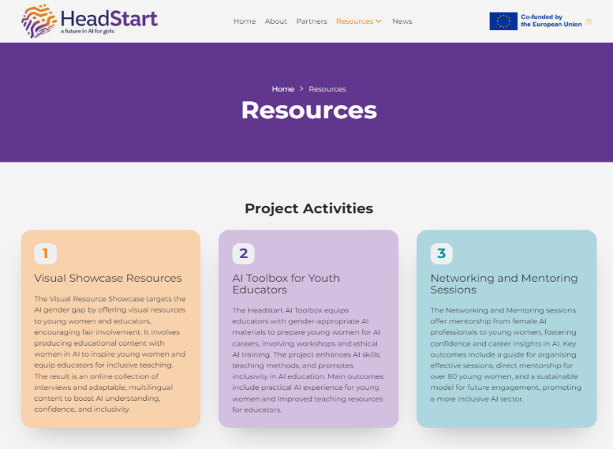


The HeadStart Resources
The HeadStart platform brings together a curated set of tools designed to support youth workers, facilitators & young women as they explore the possibilities of Artificial Intelligence. The resources are organised into four key areas:
Visual Resource Hub
AI Toolbox
A Networking and Mentoring Hub
A Directory of Women in AI
Home | Headstart

Slide 8
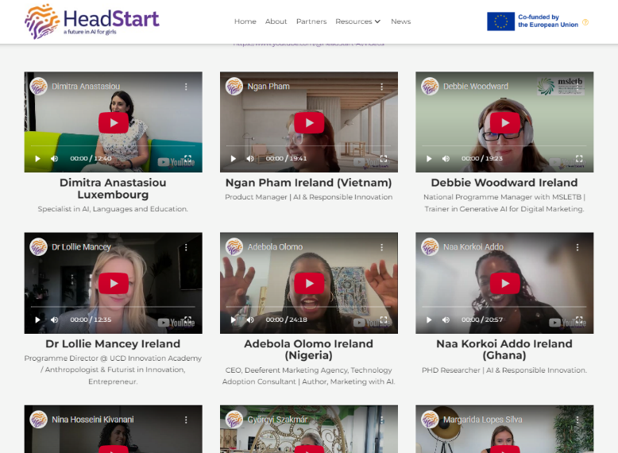
The Visual Resource Hub
The Visual Showcase presents a collection of video interviews featuring women already working in AI & related digital roles. These stories highlight diverse career paths, personal experiences, challenges & emerging opportunities within the sector.
For facilitators, the Showcase can be used to spark discussion, introduce real-world role models and inspire learners to imagine their own place in the AI landscape. The interviews also offer an accessible entry point for sessions on career exploration, digital inclusion & the future of work.
Home | Headstart

Slide 9
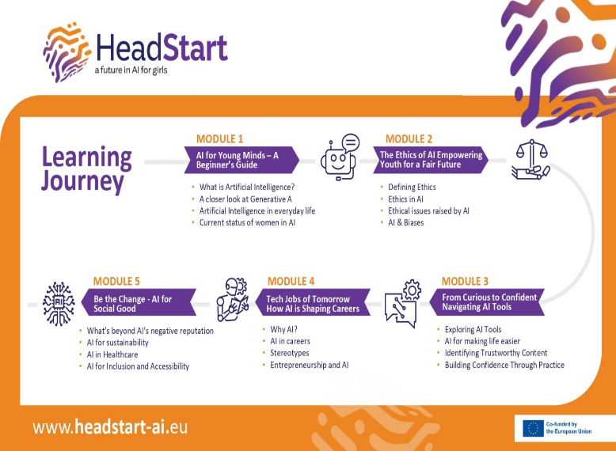
The AI Toolbox
The AI Toolbox contains the core learning materials of the project. Its 5 modules include clear explanations of AI concepts, interactive activities, ethical reflections & digital skill-building exercises. It also includes a Facilitator’s Guide offering practical advice on delivering the modules & creating inclusive learning settings.
For facilitators, the Toolbox is a ready-made solution that simplifies planning, ensures high-quality delivery & supports consistent learning outcomes. It enables youth workers to confidently lead sessions even if they have limited prior experience with AI.
Home | Headstart

Slide 10
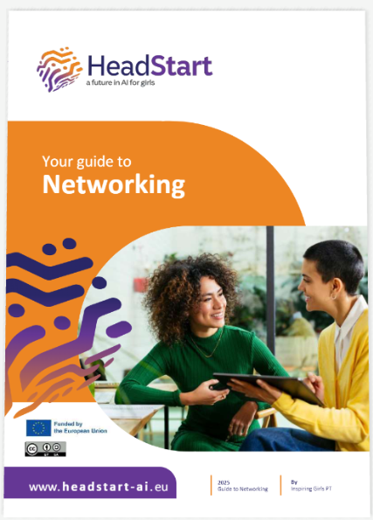
The Networking Guide
The HeadStart Networking Guide is a hands-on resource for anyone who wants to bring girls and women closer to the world of AI. It shows how even a short, informal conversation, a coffee chat, an online meet-and-greet, or a school visit can build confidence, spark curiosity, and help girls see that there is a place for them in tech.
For facilitators: Whether you’re a youth worker, teacher, or mentor, the guide gives you everything you need to plan and host sessions that open doors, build belonging, and encourage young women to imagine their future in AI.
Home | Headstart

Slide 11
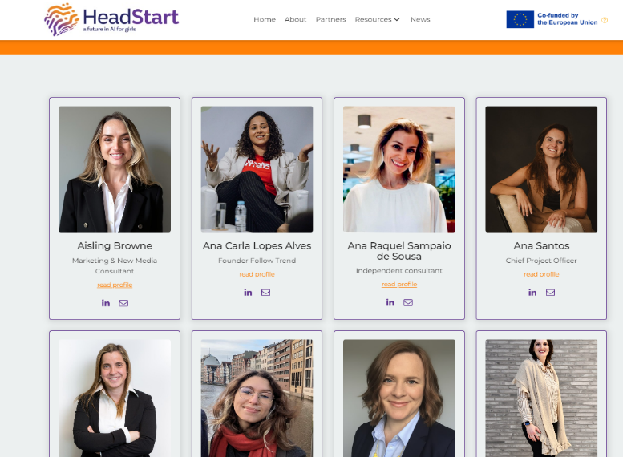
The Mentoring Hub
The HeadStart Directory of Women in AI is a growing community of professionals who are breaking barriers, sharing knowledge, and inspiring the next generation of women in technology. This space was created to make connection easy and authentic…these women are open to sharing advice & answering questions
For facilitators, the directory serves as a powerful tool to introduce real, relatable role models into learning sessions. It can be used to spark discussions around career possibilities, challenge stereotypes & demonstrate the breadth of opportunities within the AI sector.
Home | Headstart

Slide 12

The key to artificial intelligence has always been the representation

Slide 13

03
Using the Resources in Youth Work Settings

Slide 14


Using the HeadStart Tools & Resources
HeadStart’s resources are designed for flexible use across workshops, programmes, informal learning & mentoring activities.
Youth workers can begin by:
Selecting a theme, such as AI basics, career exploration or ethical thinking, that can be integrated into your sessions.
Choosing materials from the Visual Showcase or AI Toolbox to introduce the topic. Short video interviews work well as icebreakers, helping participants connect with real stories before moving into guided activities of the modules.

Slide 15
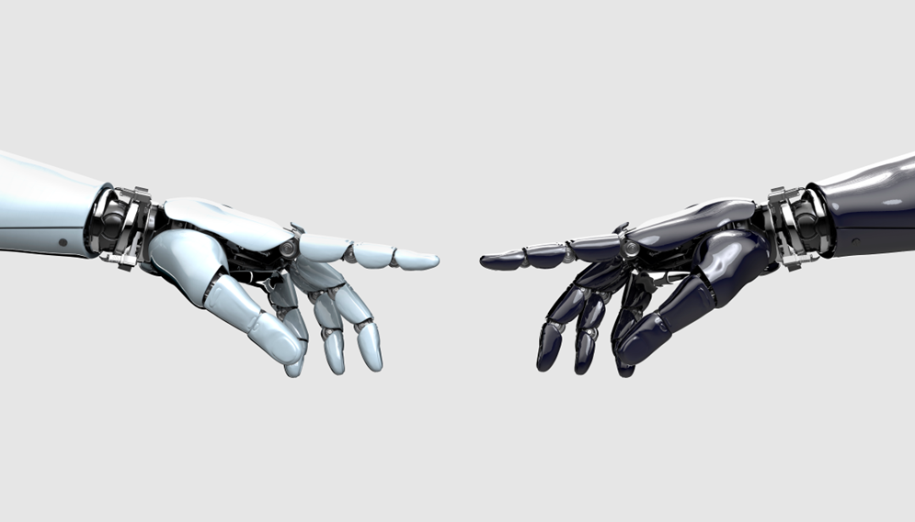
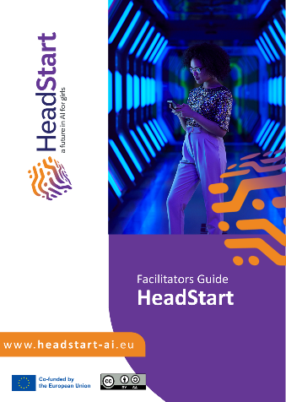
The Facilitator’s Guide provides youth workers with a clear, step-by-step structure for delivering the AI Toolbox Modules confidently, even without technical expertise.
It supports planning, inclusive facilitation & adaptable delivery, helping educators create safe, engaging sessions that build young women’s confidence in exploring AI
Using the Facilitator’s Guide

Slide 16
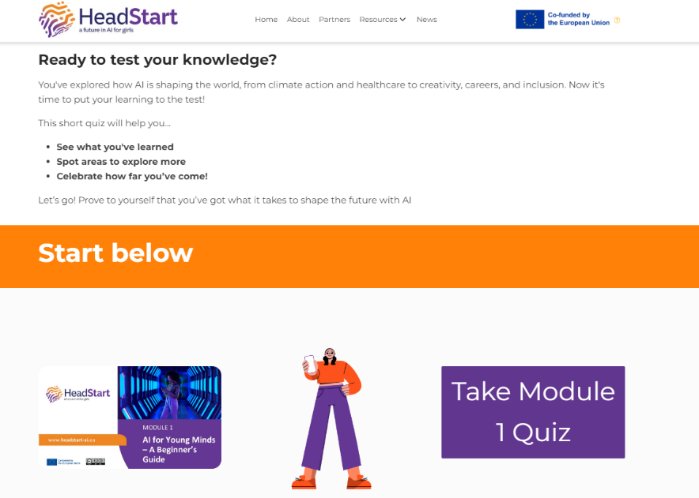
Using the
AI Toolbox Quiz
The AI Toolbox quiz can be used at the start of a session to spark curiosity & identify what learners already know, or at the end to reinforce key concepts & check understanding. It can be completed individually or in small groups, helping facilitators encourage discussion, build confidence & assess learning needs in line with the Facilitator’s Guide

Slide 17

The Networking Guide helps to equip facilitators with practical methods for organising networking & mentoring experiences and connecting girls with real women working in AI.
It strengthens their capacity to foster visibility, belonging & inspiration, benefits that directly empower young women by giving them relatable role models, confidence-building conversations & a clearer sense of future opportunities in AI.
Using the Networking Guide

Slide 18
04
Benefits for Young Women

Slide 19

Real-World Benefits for Young Women
1. Increased Confidence in Understanding AI
Through the AI Toolbox’s simple explanations, hands-on activities & guided sessions, young women gain a clear understanding of AI concepts, reducing intimidation and helping them feel capable of engaging with digital tools.
2. Exposure to Real Role Models in AI
The Visual Showcase & Directory introduce young women to women actively shaping the future of AI. Seeing relatable professionals helps them recognise that they belong in these fields and can pursue similar paths.

Slide 20

Real-World Benefits for Young Women
3. Clearer Insight into Future Careers
With the AI career-focused modules & mentoring opportunities, young women learn about real job roles, emerging sectors & the skills needed to thrive…helping them make informed education or career choices.
4. Strengthened Digital Skills
Practical sessions on ChatGPT, Canva AI & ethical thinking support everyday digital skills, enabling learners to use AI tools safely, creatively & confidently in school, work or personal projects.

Slide 21

How HeadStart Translates to Real Opportunities
5. Access to Supportive Networks & Mentoring
The Networking Guide & Mentoring Hub help facilitators connect learners with women working in AI. These short interactions can boost confidence, open doors & help young women envision their place in the digital world.
6. Reduced Stereotypes & Barriers
By highlighting diverse women on the platform and providing inclusive learning experiences, HeadStart challenges the stereotype that AI is “not for girls,” empowering young women to see AI as a space where their voices matter.

Slide 22
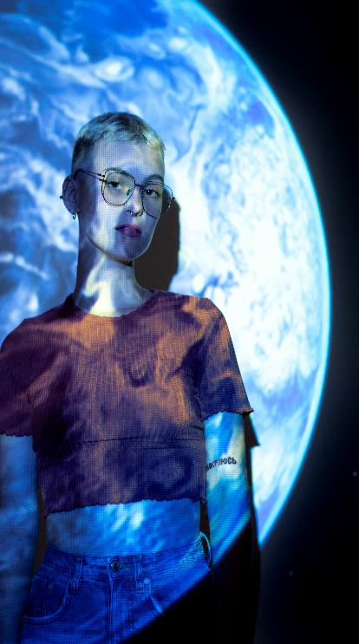
How HeadStart Translates to Real Opportunities
7. Motivation to Explore AI Creatively
Hands-on activities show learners how AI can support creativity, design, storytelling, problem-solving …encouraging them to use technology as a tool for expression and innovation.
8. A Sense of Belonging in Tech Spaces
As noted in the Networking Guide, even a short conversation with a woman in tech can improve confidence, spark curiosity & affirm that young women have an important role in shaping the future of AI

Slide 23

05
Example Activities

Slide 24

Meet the Role Model (Visual Showcase)
Purpose: Reduce intimidation and activate prior knowledge
Time: 5–10 minutes
How it works:
Play one short video interview from the Visual Showcase.
Ask learners:
  “What part of her journey felt relatable?”
  “What skills helped her succeed?”
  “What surprised you?”
Invite learners to share one takeaway or aspiration.
Benefits: Encourages belonging, challenges stereotypes & builds self-belief through real-world examples.
01
Activity

Slide 25
AI Basics Warm-Up Quiz (AI Toolbox)
Purpose: Inspire & build confidence through relatable stories.
Time: 10–15 minutes
How it works:
Use the AI Toolbox quiz at the start or end of a session.
Learners complete it individually or in pairs.
Discuss 2–3 answers together:
  “What did you learn?”
  “What did you find surprising?”
Benefits: Creates a fun, low-pressure learning environment & helps facilitators gauge understanding
02
Activity

Slide 26
Story Remix with ChatGPT (AI Toolbox)
Purpose: Build creative confidence using AI tools.
Time: 10–15 minutes
How it works:
Ask ChatGPT to write a short story (e.g., “A girl discovers a friendly AI assistant”).
Invite learners to remix it by changing the prompt:
Different tone, location or character
Different cultural or creative elements
Compare versions & discuss the impact of prompting.
Benefits: Shows learners that they can control AI tools, not the other way around; supports digital creativity & experimentation.
03
Activity

Slide 27
Designing an Inclusive Prompt (Ethics)
Purpose: Build awareness of AI bias & inclusive design.
Time: 10–15 minutes
How it works:
Learners write a basic prompt (e.g., “Create an image of a scientist.”).
Discuss what the AI might produce.
Learners then write a more inclusive version:
“Create an image of a female scientist from Kenya working with AI solutions for farming.”
Compare versions & discuss the impact of prompting.
Benefits: Shows how small changes in wording can challenge stereotypes, an important theme in the AI ethics sessions
04
Activity

Slide 28
Speed Mentoring Mini-Round (Mentoring Hub)
Purpose: Build real connections with women in AI.
Time: 20 minutes
How it works:
Invite one local woman working in AI or select someone from the Directory.
Learners meet her in small groups for 5–7 minutes.
Suggested questions:
  “What advice would you give your younger self?”
  “What do you enjoy most about your work?”
End with a reflection:
  “What inspired you today?”
Benefits: Boosts confidence, builds networks & brings AI careers to life, as emphasised in the Networking Guide
05
Activity

Slide 29
Thank you
www.headstart-ai.eu

